Slide 1
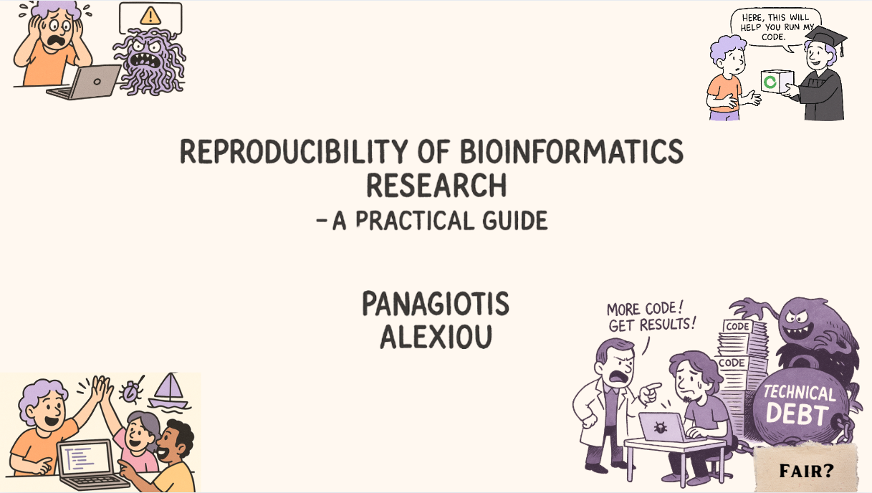

Slide 2
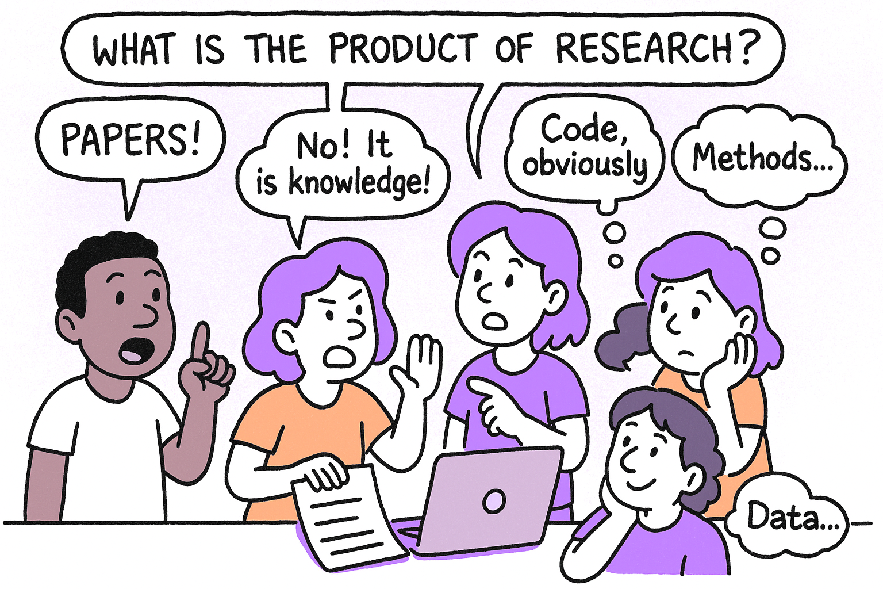
Discussion: What is the concrete product of research?

Slide 3
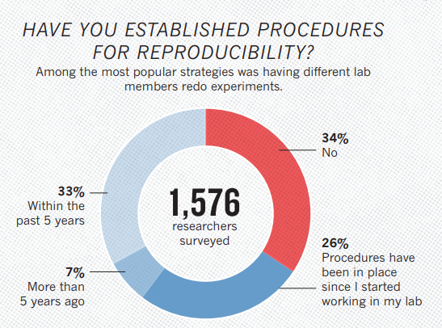
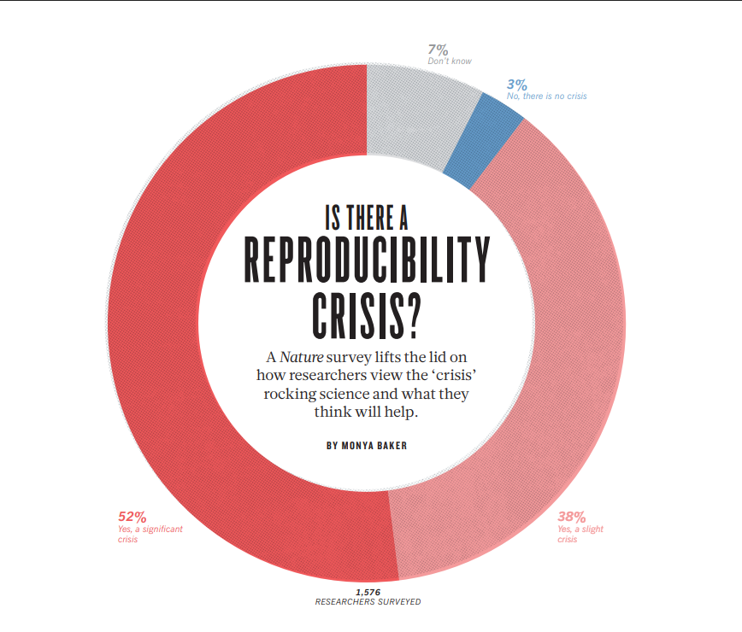
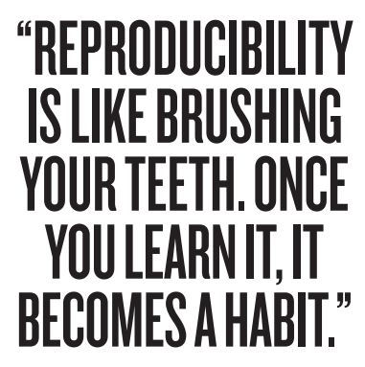
More than 70% of researchers have tried and failed to reproduce another scientist's experiments,
and more than 50% have failed to reproduce their own experiments.
https://www.nature.com/articles/533452a

Slide 4
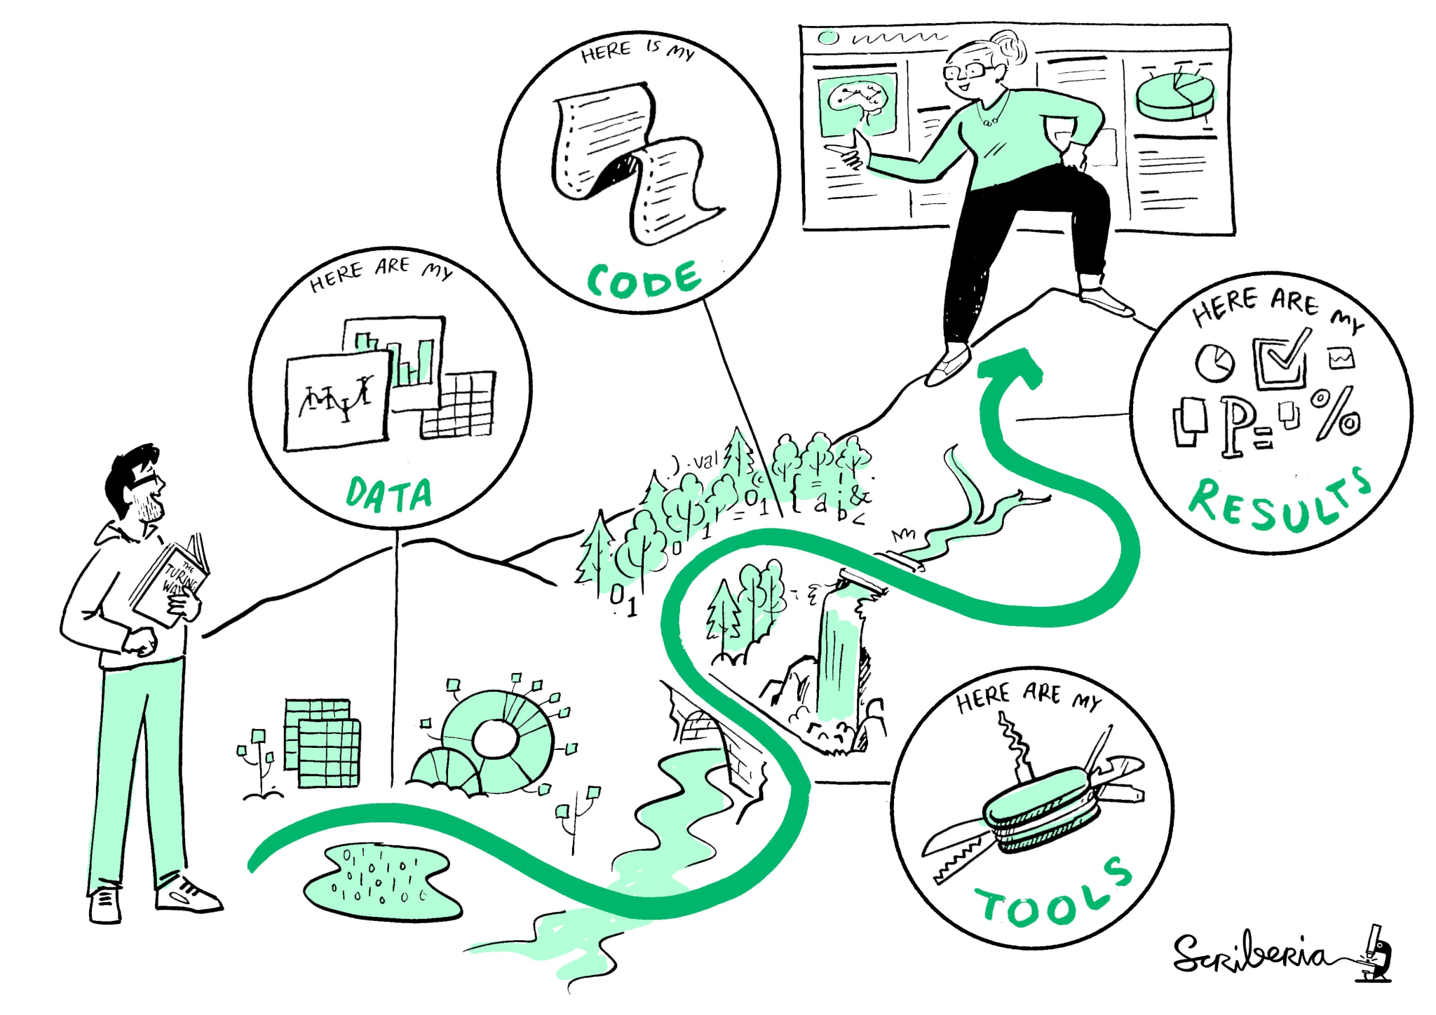

What does reproducible mean in BioIT?
Same Inputs → Same Outputs
Transparent Workflows
Well described data and tools
https://ttw-rtd.readthedocs.io/

Slide 5
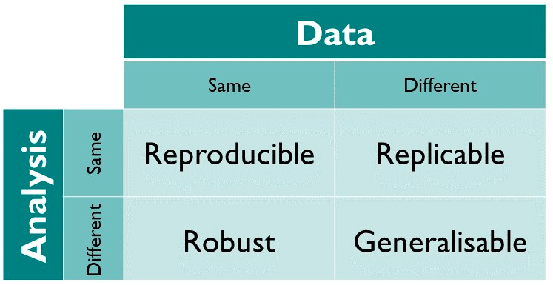
* Some research will use sensitive data that cannot be shared → Reproducible doesn’t always mean Open!

Slide 6
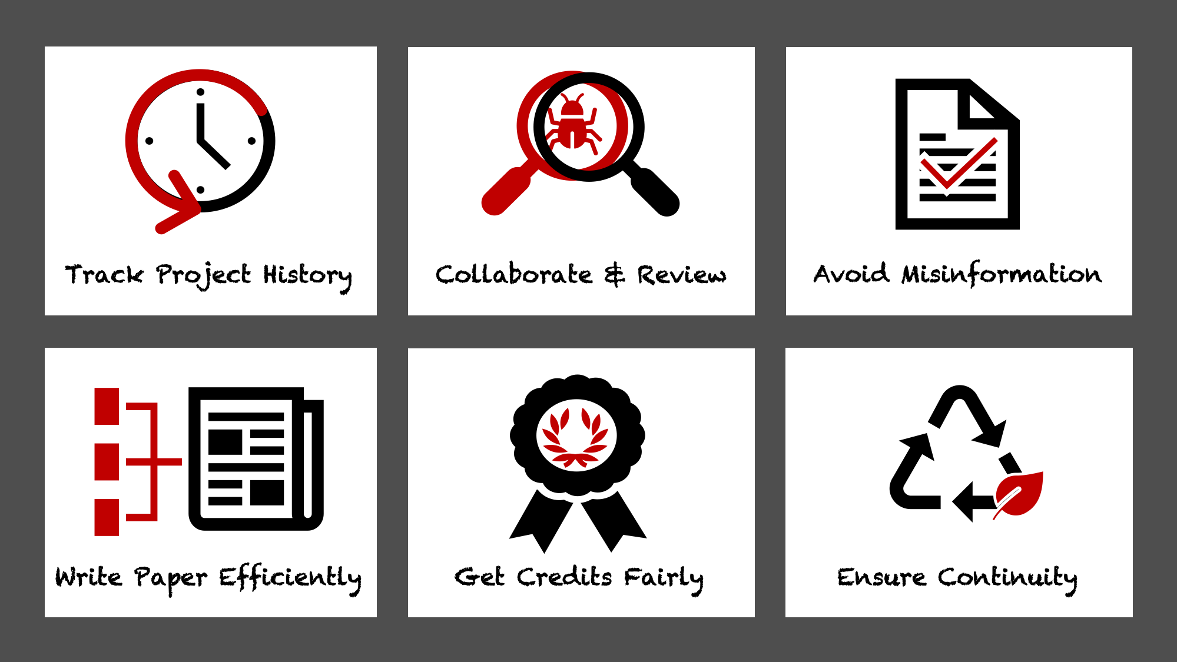

Slide 7
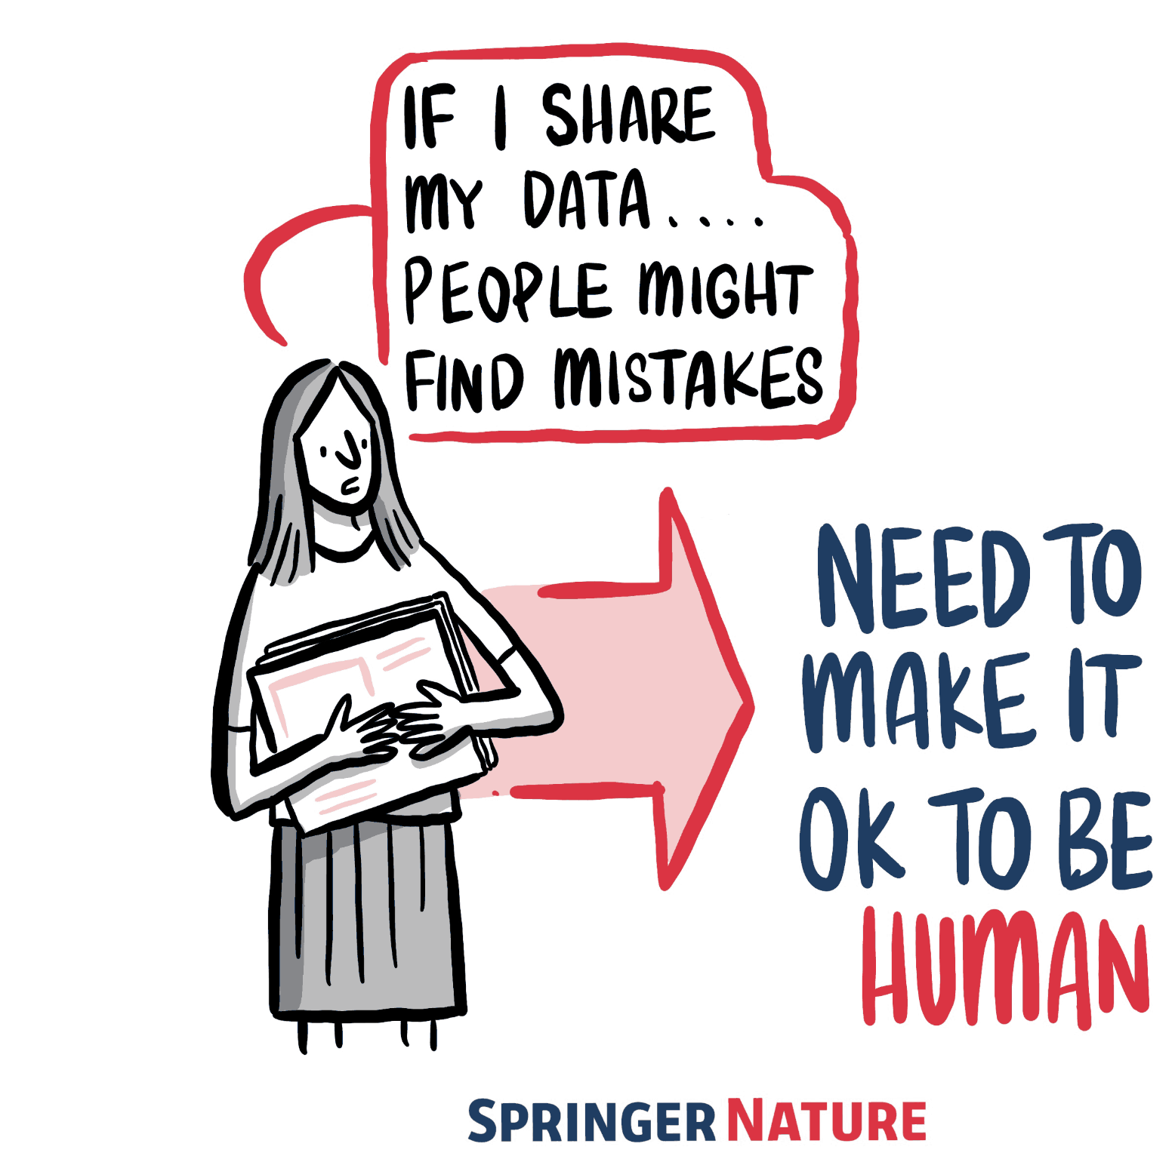
Limited incentives to give evidence against yourself
Takes time
Big data and complex computational infrastructure
Held to higher standards than others
Requires additional skills
Not considered for promotion

Slide 8
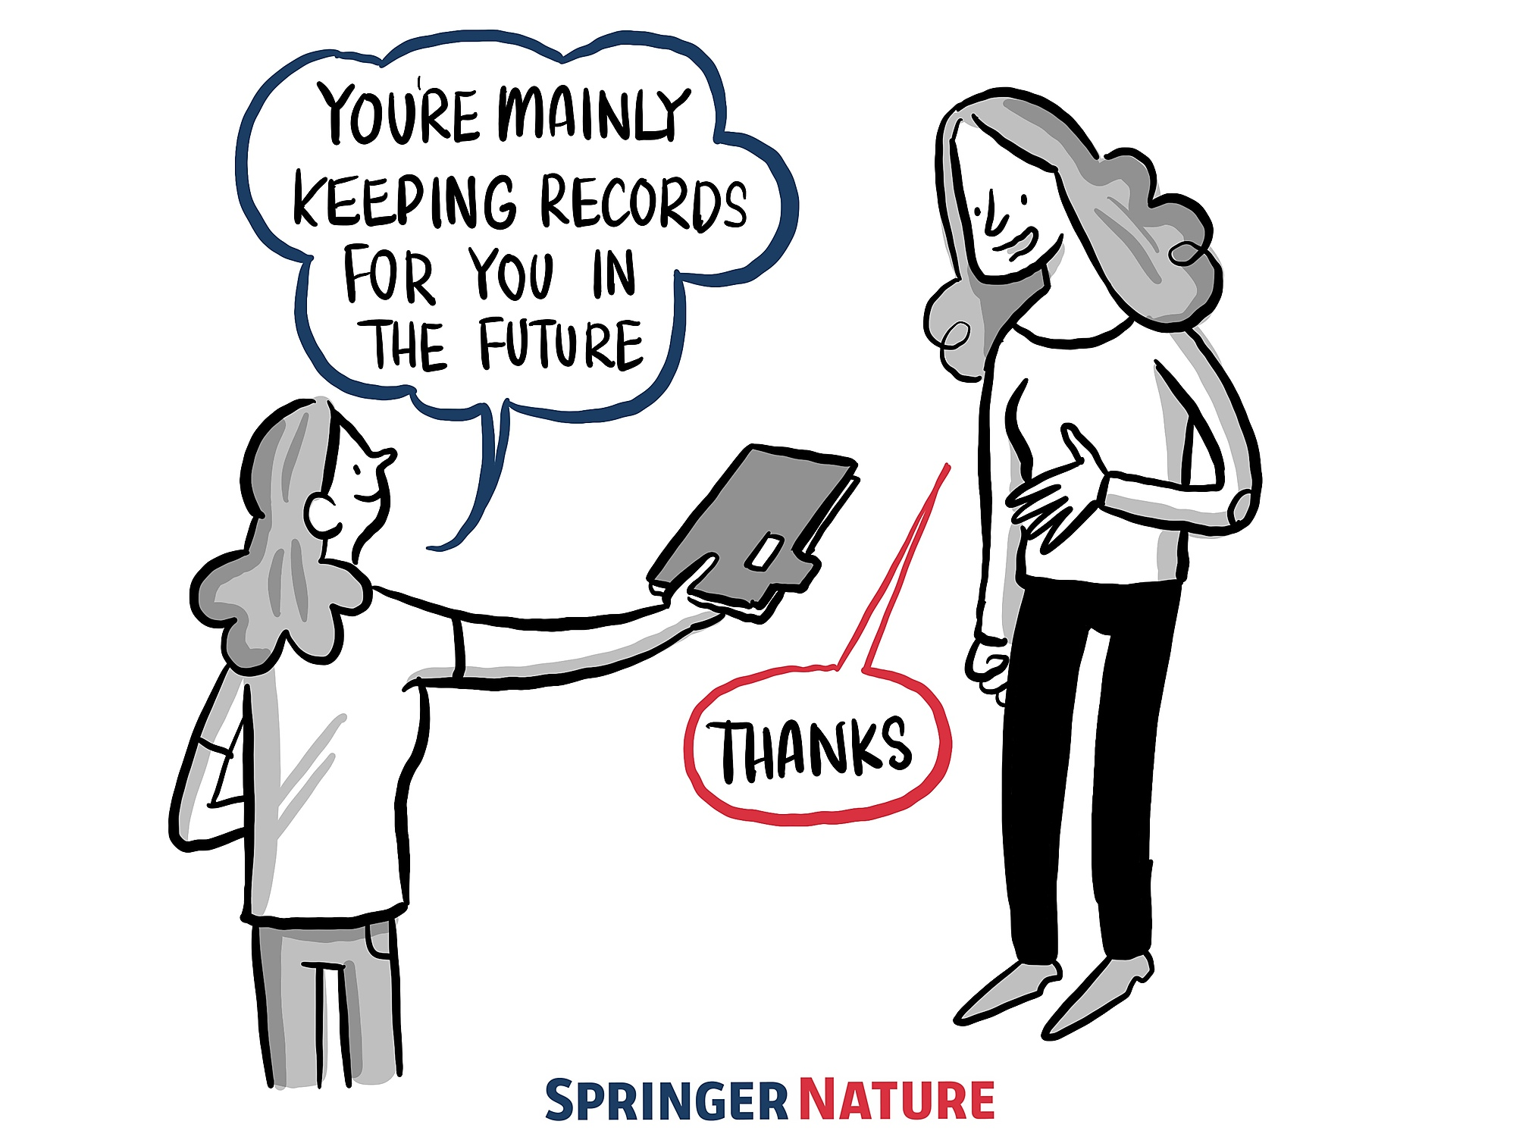

Slide 9
…when it comes to reproducibility…
A good Bioinformatics project:
MUST HAVE
SHOULD HAVE
COULD HAVE
WON’T HAVE

Slide 10
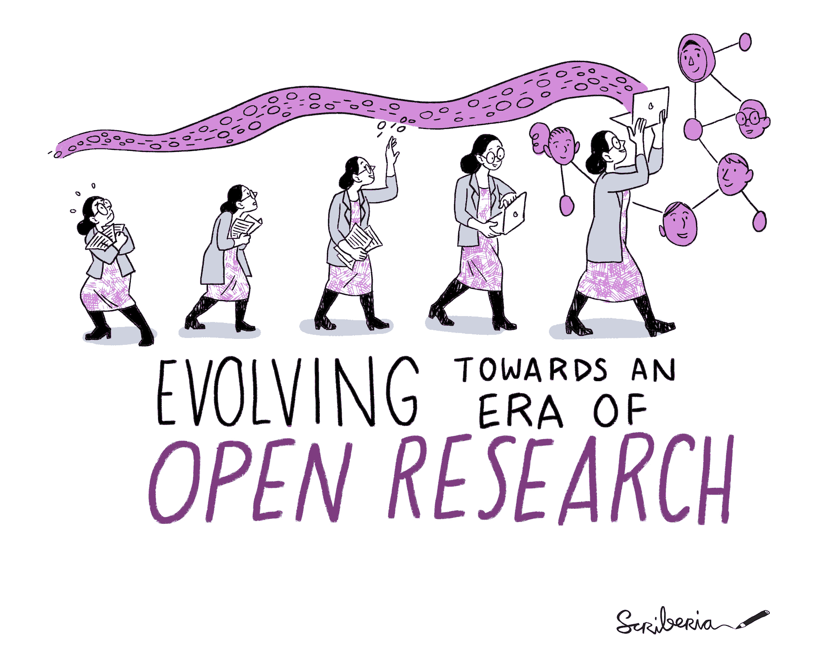
To achieve openness in research, each element of the research process should:
Be publicly available: It is difficult to use and benefit from knowledge hidden behind barriers such as passwords and paywalls.
Be reusable: Research outputs need to be licensed appropriately, so that prospective users know any limitations on re-use.
Be transparent: With appropriate metadata to provide clear statements of how research output was produced and what it contains.
“as open as possible, as closed as necessary”

Slide 11
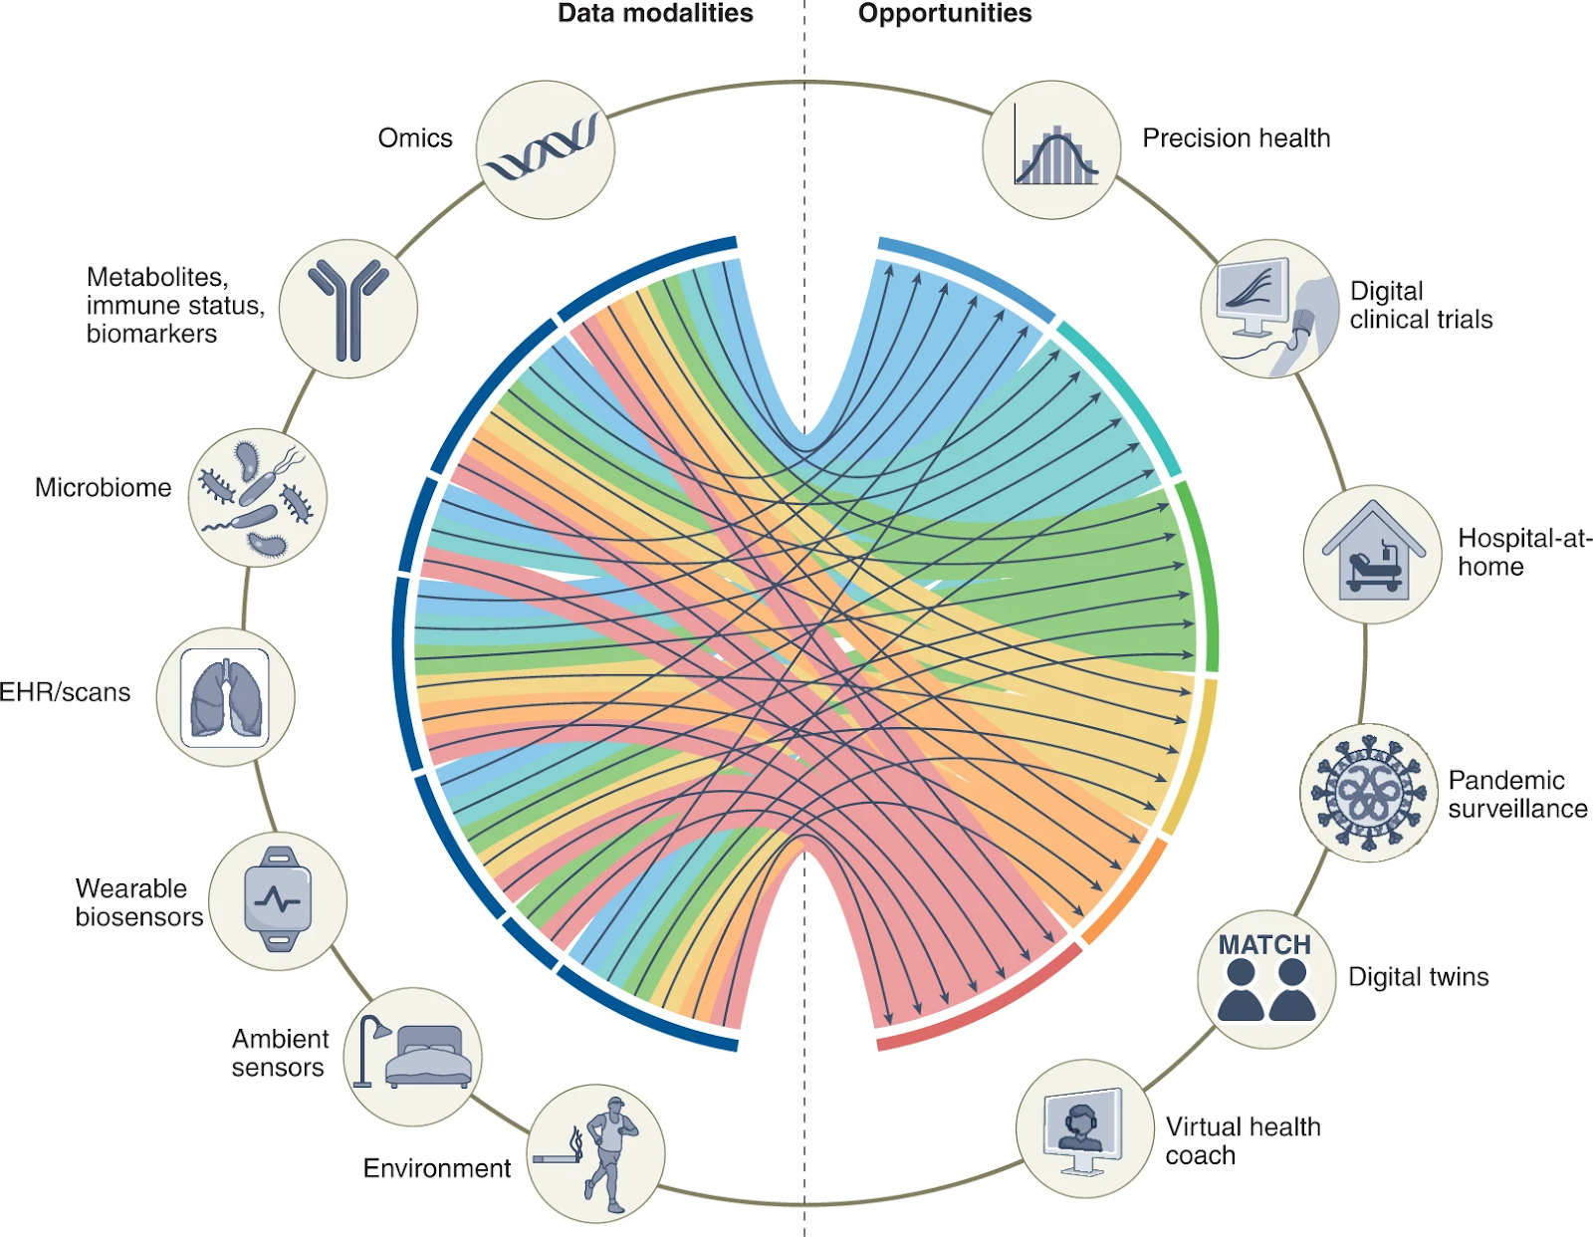

DATA
is the new gold

Slide 12
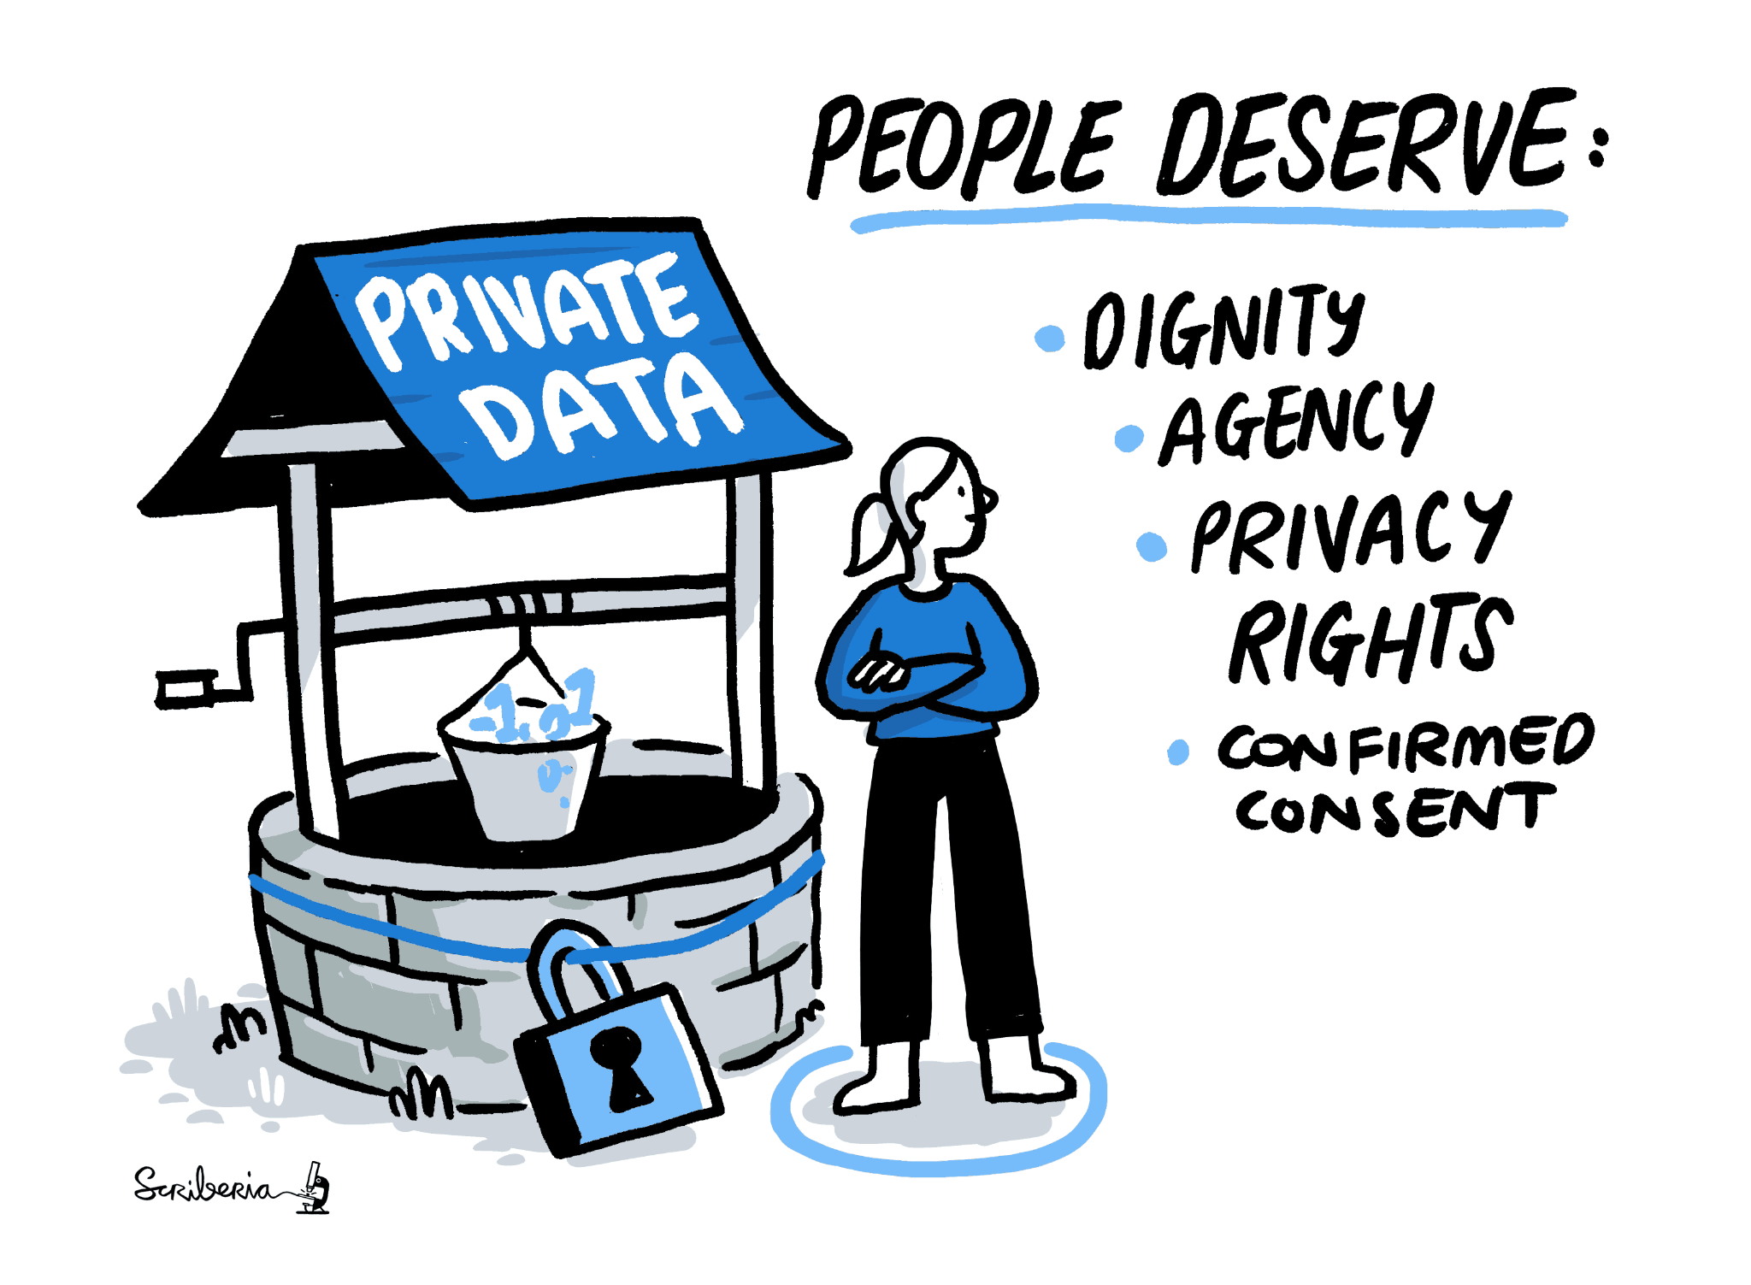
Open Data
It is generally difficult or impossible to reproduce a study without the original data.
The data cannot be reused or incorporated into new work by other researchers if they cannot obtain access to it.
Then why isn’t data always Open?
Organising data in a presentable and useful way is challenging (46%)
Researchers are unsure about copyright and licensing (37%)
Researchers do not know which repository to use for different data types (33%)

Slide 13
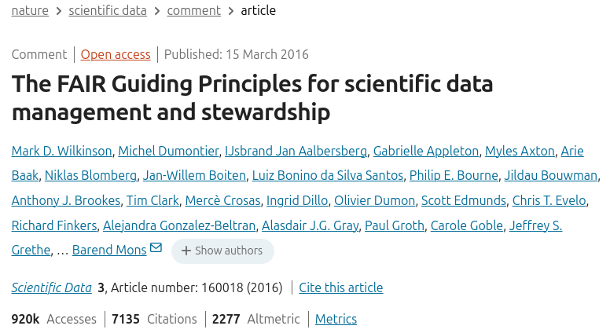
https://www.go-fair.org/fair-principles/

Slide 14
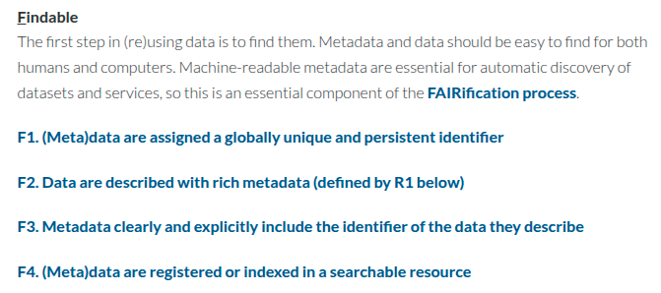

Slide 15
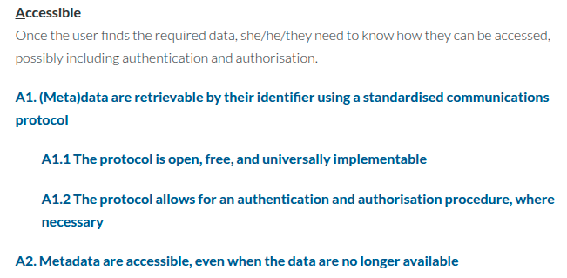

Slide 16
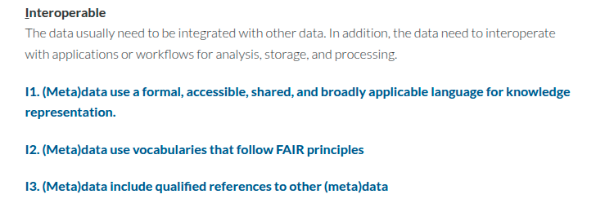

Slide 17
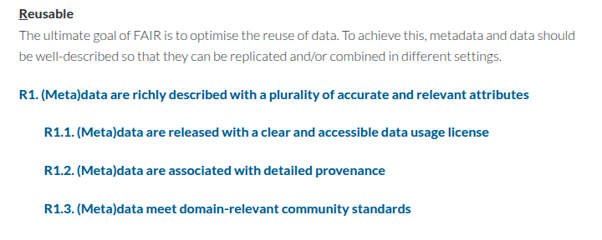

Slide 18
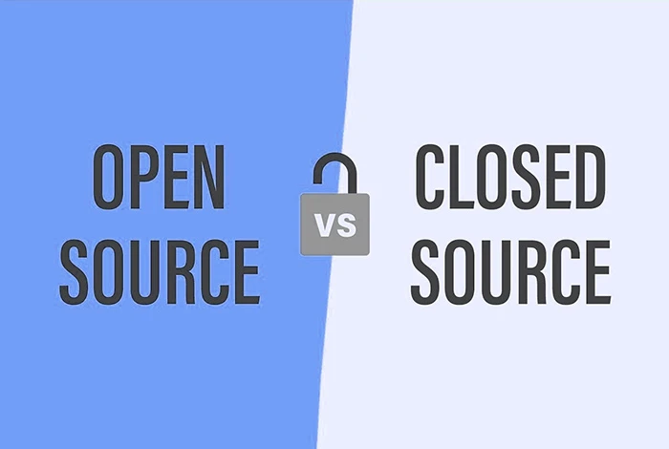
SOFTWARE

Slide 19
Open vs Closed Source Software
If you release your analysis code and software under an open license (e.g. MIT, Apache 2.0) it can be reused without issues.
Public code repositories (GitHub, GitLab) enable others to inspect, run, and adapt your code.
ATTN:
If you are working for a university project, all code (and other IP) is owned by the university and the PI must sign off any publication of code (or data).

Slide 20
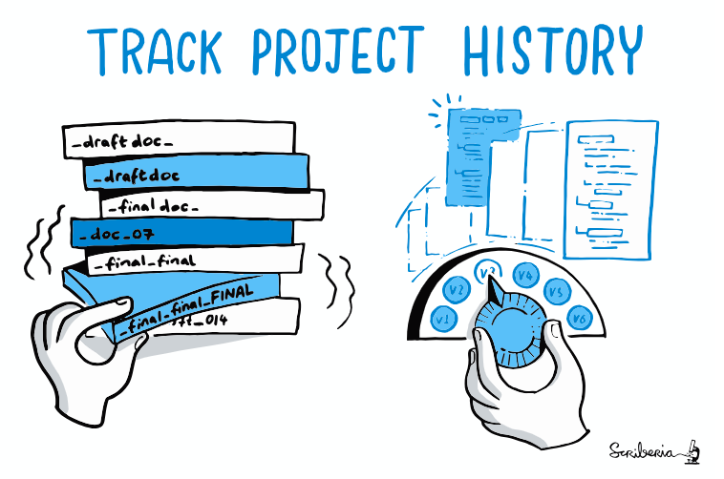
Version Control
-
git

Slide 21
Why use a Version Control System?
A VCS records every change made to your project over time.
Git is the most widely used VCS in research; hosted on platforms like GitHub, GitLab, and Bitbucket.
Helps manage different versions of your project (e.g., code, text, documentation).
Enables collaboration: multiple people can work on the same files without overwriting each other.
Creates a timeline of your work: useful for troubleshooting, reproducibility, and writing papers.
Supports branching: try ideas or features without affecting the main project.
Encourages clean, modular, documented development practices

Slide 22
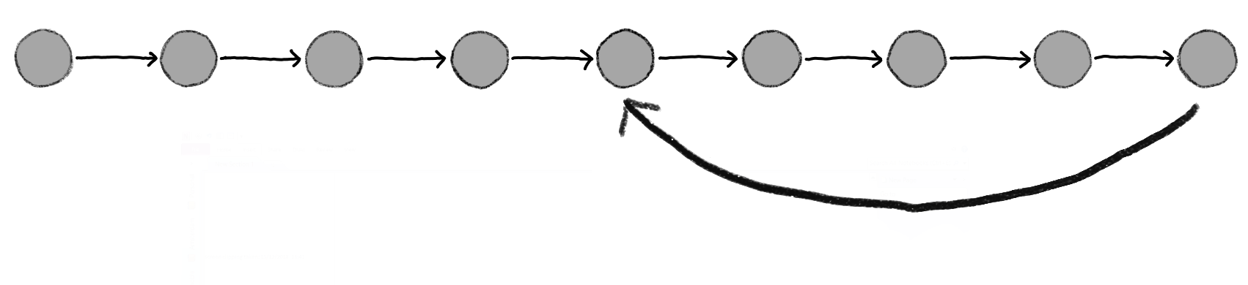
Single Branch

Slide 23
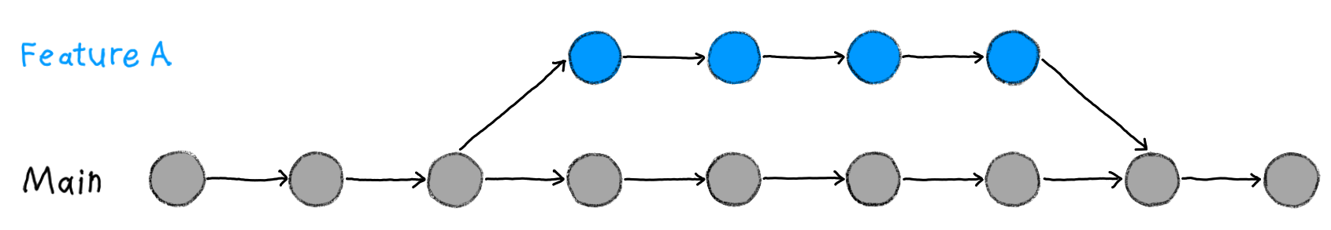
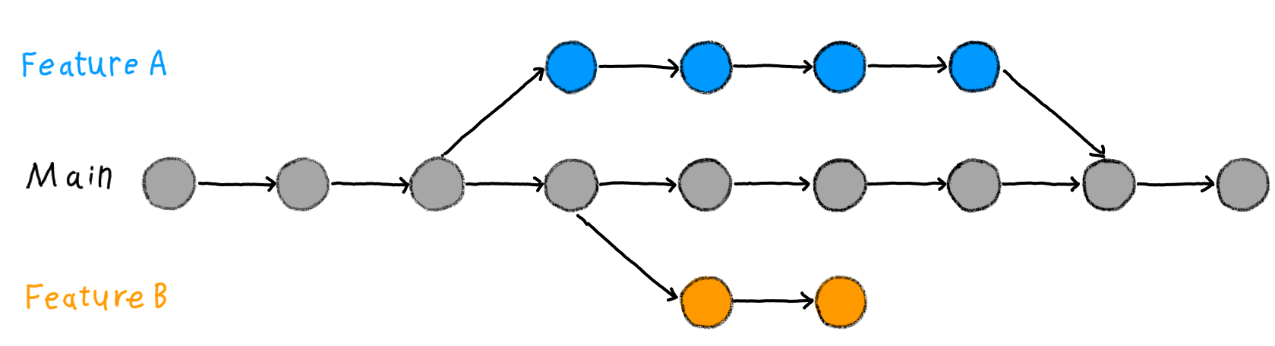
Feature Development Branch

Slide 24
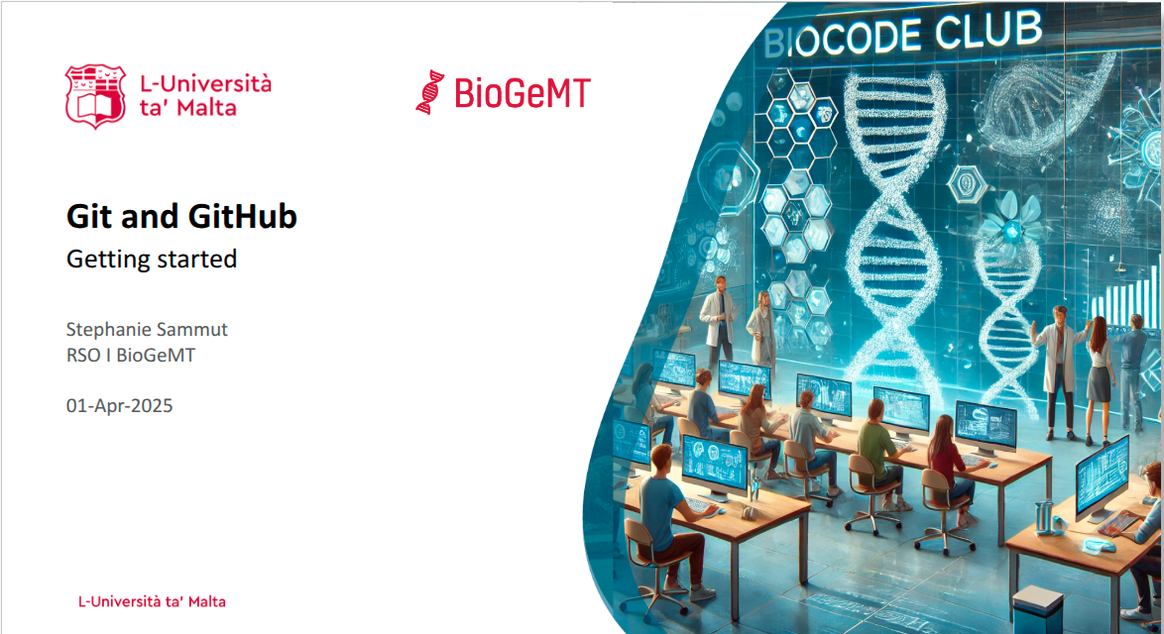

Git Basic Concepts
Steph Sammut

Slide 25
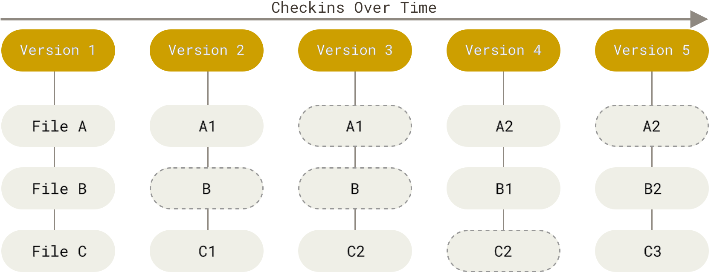
Git data is like a series of snapshots of a miniature filesystem
Git stores a reference to each snapshot (version)
You decide when to take a snapshot!
Notes:
Git thinks of its data like a series of snapshots of a filesystem.
It stores a reference to each snapshot.
You decide when to take the snapshots.
For example, you have a filesystem with 3 files A, B and C, in version 1.
You make changes to file A and C, and in version 2, you can see that Files A and C change to A1 and C1, but file B remains the same.
So git will store a reference to A1, C1 and B from version 1.
And so on.

Slide 26

Basic concepts
1 of 3 STATES
FILE
modified
staged
committed
The file has changes in it
Notes:
Some basic concepts in git. A file can exist in 1 of 3 states.
Modified means that you have changed the file but have not committed it to your database of snapshots yet.

Slide 27
Basic concepts
1 of 3 STATES
FILE
modified
staged
committed
The file has changes in it
The modified file has been marked to go into your next snapshot
Notes:
Staged means that you have marked a modified file in its current version to go into your next snapshot.

Slide 28
Basic concepts
1 of 3 STATES
FILE
modified
staged
committed
The file has changes in it
The modified file has been marked to go into your next snapshot
The file is safely stored in your database as part of a snapshot
Notes:
Committed means that the data is safely stored in your local database. It is part of your snapshot.

Slide 29
Basic concepts
1 of 3 STATES 1 of 3 STAGES
FILE
modified
staged
committed
working
tree
staging area
git
repo
Notes:
This leads us to the three main sections or stages of a Git project:
the working tree,
the staging area, and
the Git directory or repository.

Slide 30
Basic concepts
1 of 3 STATES 1 of 3 STAGES
FILE
modified
staged
committed
checkout
working
tree
staging area
git
repo
add
commit
Notes:
The working tree is a single checkout of one version of your project. The files are pulled out of the database in the Git directory and placed on disk for you to use.
The staging area stores information about what will go into your next commit.
The Git directory is where Git stores the snapshots of your project. This is the most important part of Git, and it is what is copied when you clone a repository from another computer or remote.

Slide 31
Basic concepts
checkout
working
tree
staging area
git
repo
add
commit
local
Notes:
Now all of this occurs locally on your machine, which is why you can run most git commands offline.

Slide 32

Basic concepts
checkout
working
tree
staging area
git
repo
git
repo
add
commit
local
remote
Notes:
But there is also the remote git repository, which is hosted on GitHub.

Slide 33

Basic concepts
ssh
checkout
working
tree
staging area
git
repo
git
repo
add
commit
local
remote
Notes:
We connect our local repo to the remote repo via SSH protocol.
You keep your private key on your local machine.
And you put your public key on your GitHub account.
And this way you can connect your local repo to your remote repo without providing you username and password every time.

Slide 34
Basic concepts
checkout
fetch
working
tree
staging area
git
repo
git
repo
push
add
commit
local
remote
Notes:
Then you can use git commands to push or pull changes between your repositories.
pull = fetch + merge

Slide 35
Real Life Example
https://github.com/BioGeMT/Agentomics-ML/

Slide 36
Making most of git in scientific projects
Start a Git repo at the beginning of your project.
Use .gitignore to avoid tracking large or unnecessary files (e.g. .Rhistory, .ipynb_checkpoints/, .DS_Store).
Commit frequently with clear messages (e.g. "add filtering step for low-quality reads").
Push to a remote (e.g., GitHub) often – enables backup and sharing.
Tag releases that correspond to major milestones (e.g., “submitted version”).
Include a README.md to explain the project and how to run code.
Avoid committing large data files. Instead, link to them or use other tools (e.g. git LFS)
Review changes with git diff and git log to understand your progress.
💡 Tip: Treat Git history as your lab notebook for code – transparent, timestamped, and explainable.

Slide 37
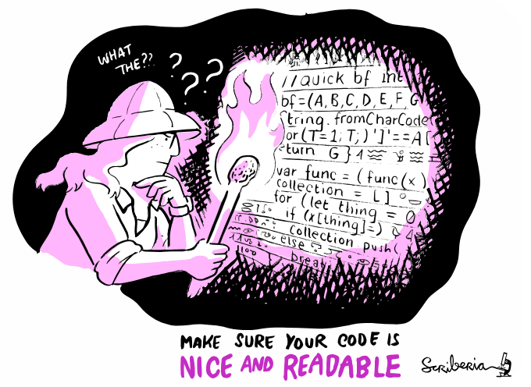
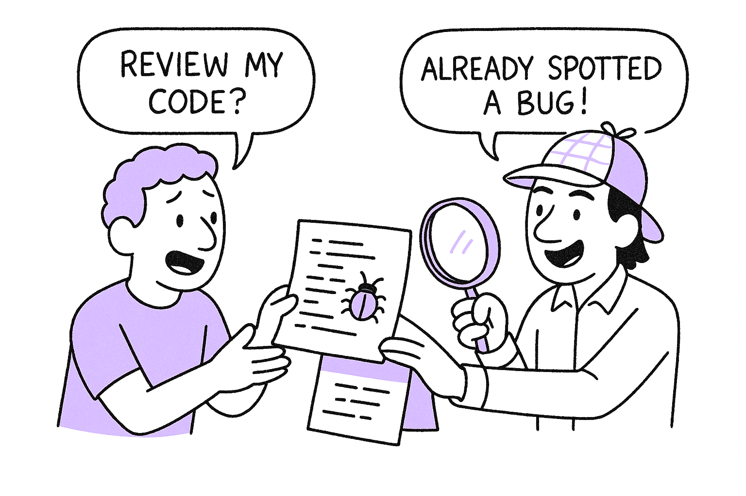
Code Review

Slide 38
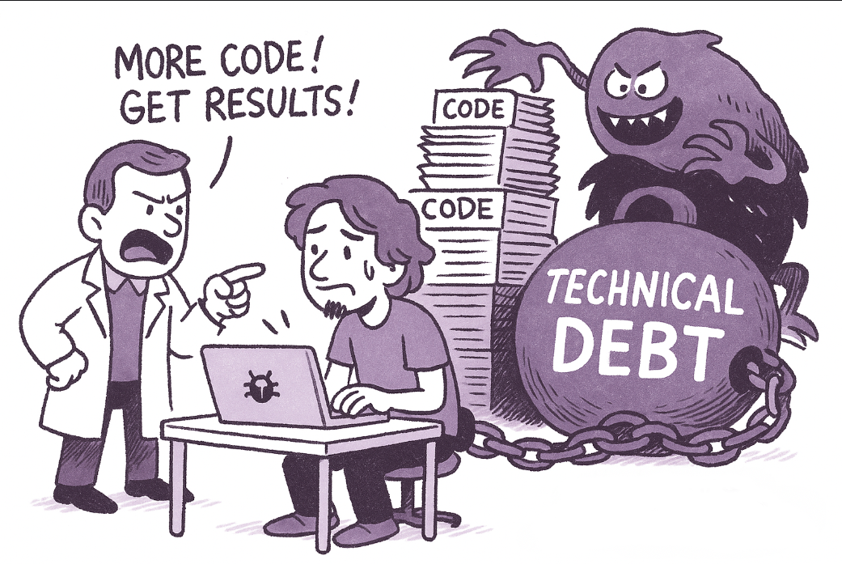

Slide 39
Code Review: Peer Quality Assurance
It's qualitative, not just technical
Strengthens team cohesion and understanding.
Reviews are:
  Common in collaborative projects.
  Useful even in solo projects with planning.
  Most effective when routine and respectful.
🧠 “Code review is about feedback, not judgment.”
✔️ Catches bugs that tests may miss
(code review catches ~55–60% of defects)
✔️ Strengthens testing strategies by exposing edge cases
✔️ Improves documentation clarity and consistency
✔️ Boosts code readability and maintainability
✔️ Enforces coding standards (PEP8, R style, project-specific)
✔️ Encourages collaboration and shared ownership of code
✔️ Onboards newcomers by exposing them to idioms and patterns

Slide 40
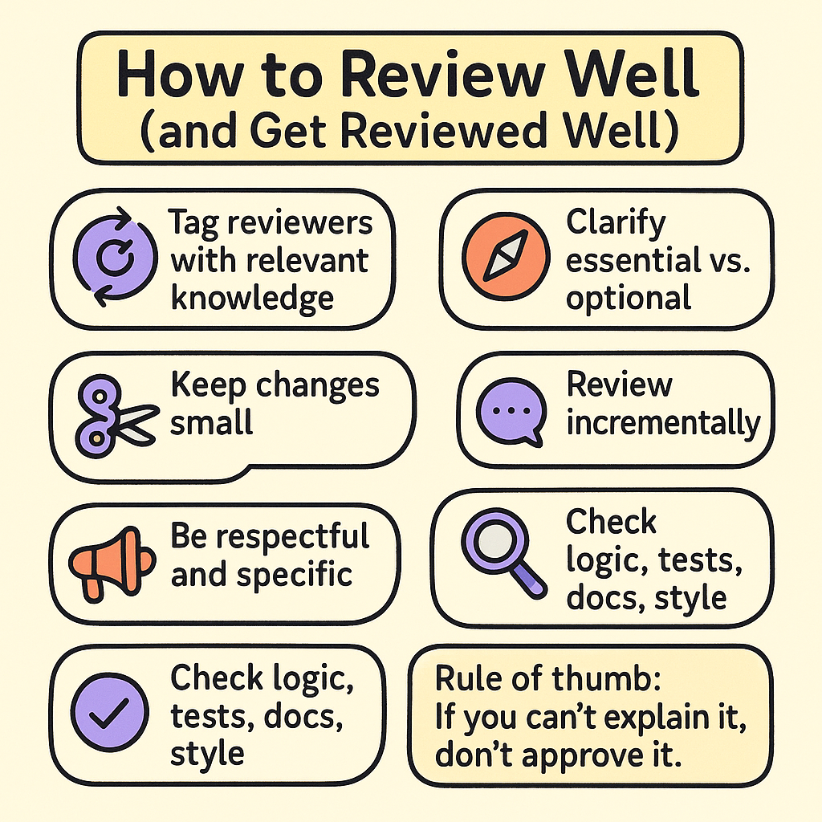
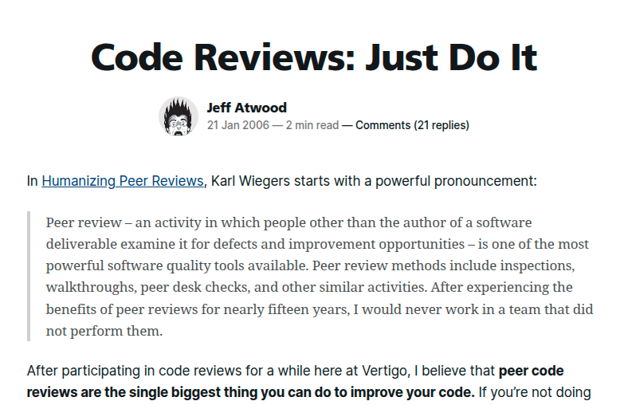
https://blog.codinghorror.com/code-reviews-just-do-it/

Slide 41
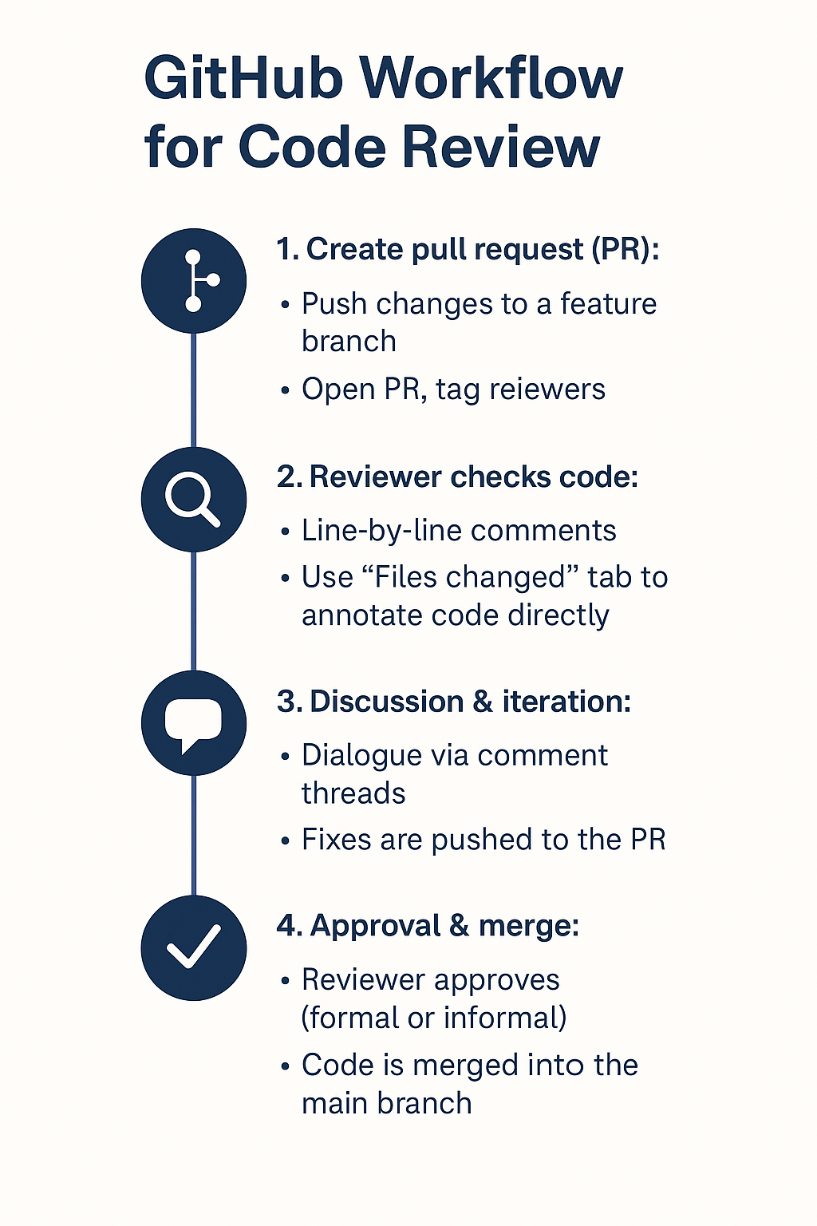
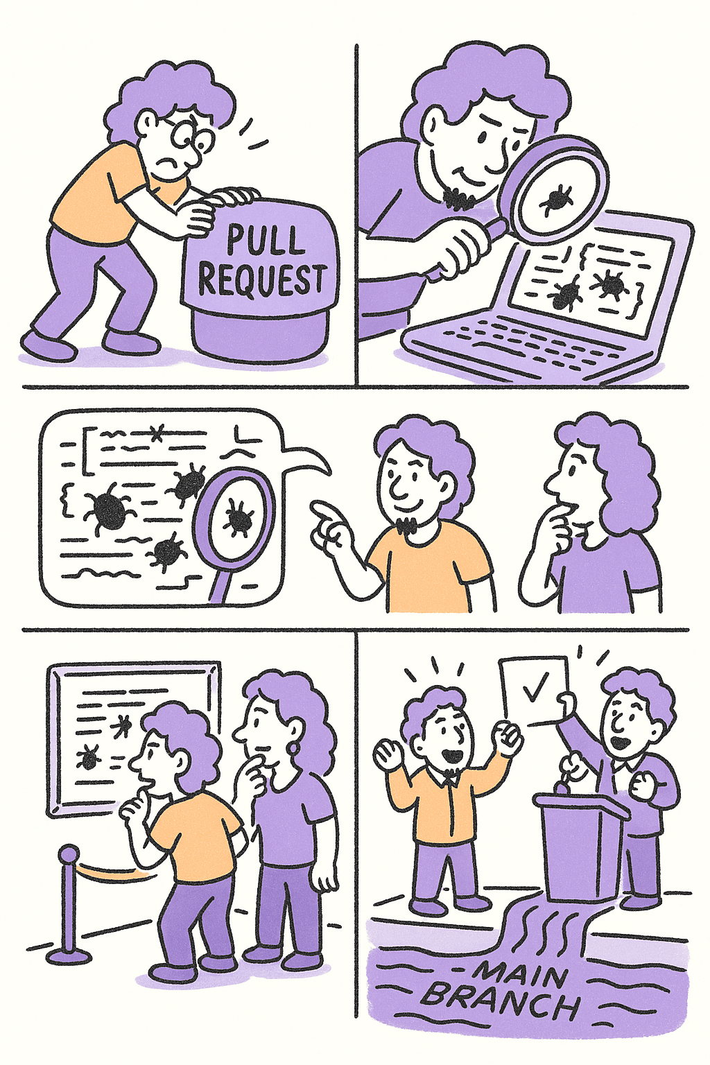
📁 Use many small PRs—not one giant one.
🔗 GitHub Docs: Reviewing Changes in Pull Requests

Slide 42
Program level checklist
Documentation
Documentation is a prerequisite for using, developing, and reviewing the program. Someone who isn’t involved with your project should understand what your code does, and what approach you’re taking. Here are some things to check for.
Is there a description of the purpose of the program or library?
Are detailed requirements listed?
Are requirements ranked according to MoSCoW? (Must Have, Should Have, Could Have, Won’t Have)
Is the use and function of third-party libraries documented?
Is the structure/architecture of the program documented?
Is there an installation manual? (README?)
Is there a user manual?
Is there documentation on how to contribute? (IF YOU ACCEPT CONTRIBUTIONS)
  Including how to submit changes
  Including how to document your changes
Architecture
These items are mainly important for larger programs, but may still be good to consider for small ones as well.
Is the program split up into clearly separated modules?
Are these modules as small as they can be?
Is there a clear, hierarchical or layered, dependency structure between these modules?
  If not, the functionality should be rearranged, or perhaps heavily interdependent modules should be combined.
Can the design be simplified?

Slide 43
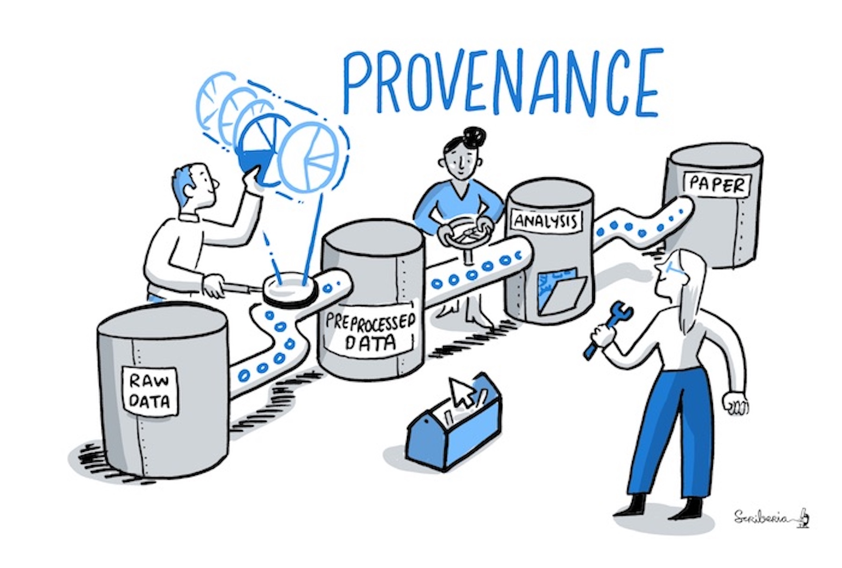
Version Control
-
data

Slide 44
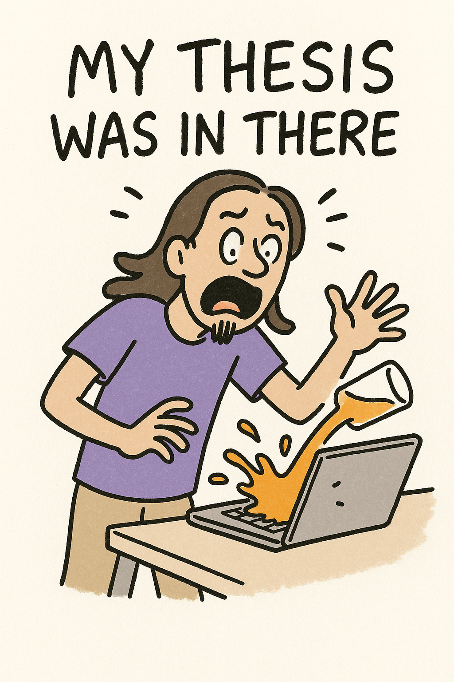
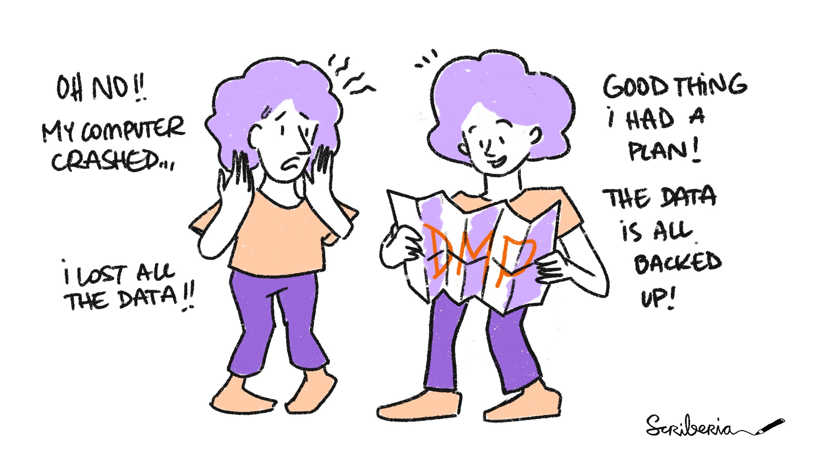

Slide 45
What about Data?
Version control isn't just for code — data changes too, and must be tracked.
Reproducibility requires knowing exactly which version of the data was used for each result.
Avoid manually renaming files like dataset_final_v2_FINAL_revised.csv.
Instead, use a systematic method to track raw, cleaned, and processed datasets.
Benefits:
  Detect and fix mistakes in data transformations.
  Reproduce past results exactly.
  Share workflows without ambiguity.
Combine data versioning with metadata to fully document data sources, changes, and context.
💡 Think of data as first-class citizens in your research pipeline — they deserve version control too.

Slide 46
How to Version Data?
Git for small data files: Text files, CSVs, JSONs can be versioned directly with Git.
Use .gitignore to exclude large, binary, or intermediate files.
Avoid committing raw data if it's large or under privacy constraints — link to a DOI or use DVC.
DVC (Data Version Control): Tracks data versions like Git tracks code, without storing the data in the repo.
  Supports remote storage (S3, GDrive, etc.).
  Enables reproducible pipelines and data provenance.
  🔗 https://dvc.org
Alternatives:
  Git LFS (Large File Storage): For binary files, but more limited than DVC.
  Checksum files: e.g., MD5 hashes to verify file identity.
Keep raw data immutable. Processed data should be reproducible via scripts.
🛠 Pro tip: Always version-control the scripts that generate derived data — then your data is reproducible by definition.

Slide 47
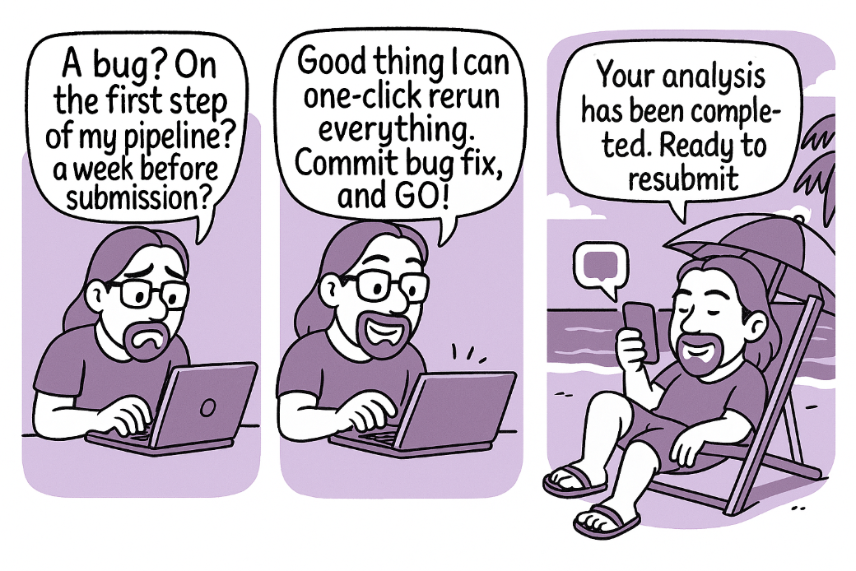

Slide 48
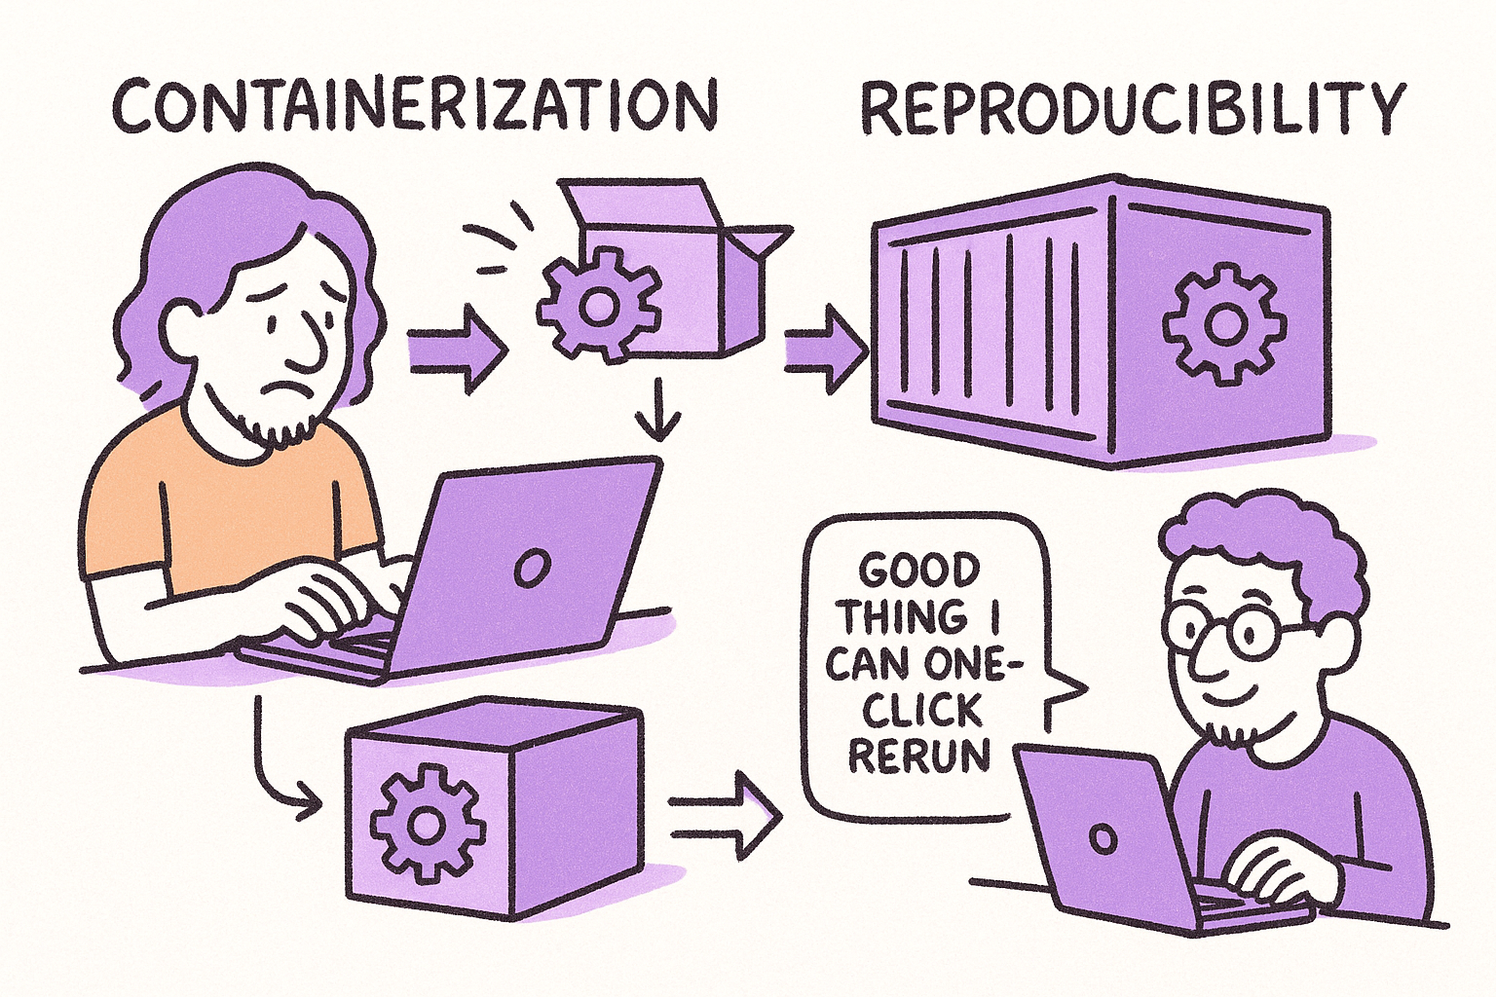
Reproducible Environments

Slide 49
“It worked on my machine” is not good enough
Code depends on specific versions of libraries and system tools.
Results can differ due to:
  OS version
  Library updates
  Conflicting packages
A reproducible environment captures everything your code needs to work consistently across systems.
Enables others (and future you) to run the same code, get the same result.
💡 Rule: If your analysis is not reproducible on a clean machine, it's not reproducible.

Slide 50
Ways to Preserve Your Computational Environment
Manual listing: requirements.txt, sessionInfo(), pip freeze
Virtual environments: Local isolation (conda; renv)
Package locking: Save exact versions
Virtual machines (VMs): Snapshots of entire OS
Containers (Docker/Singularity): Lightweight, portable environments

Slide 51
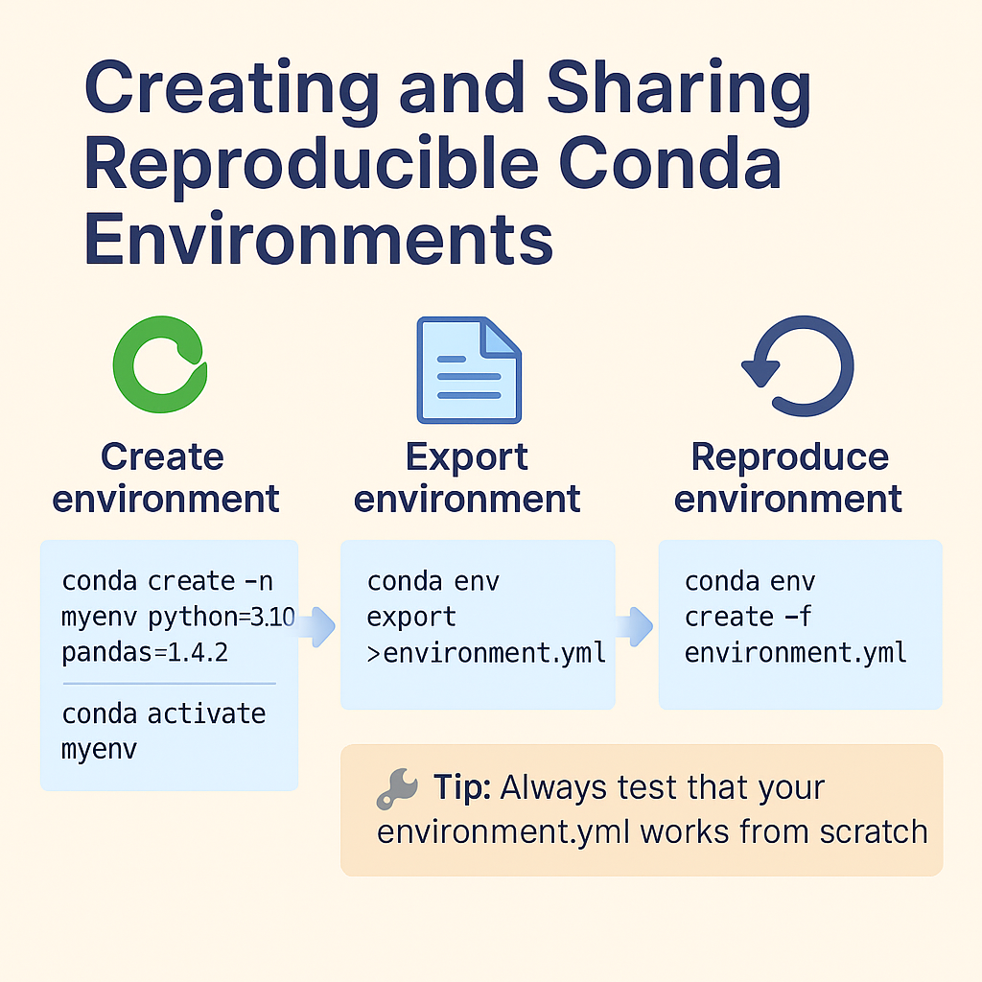

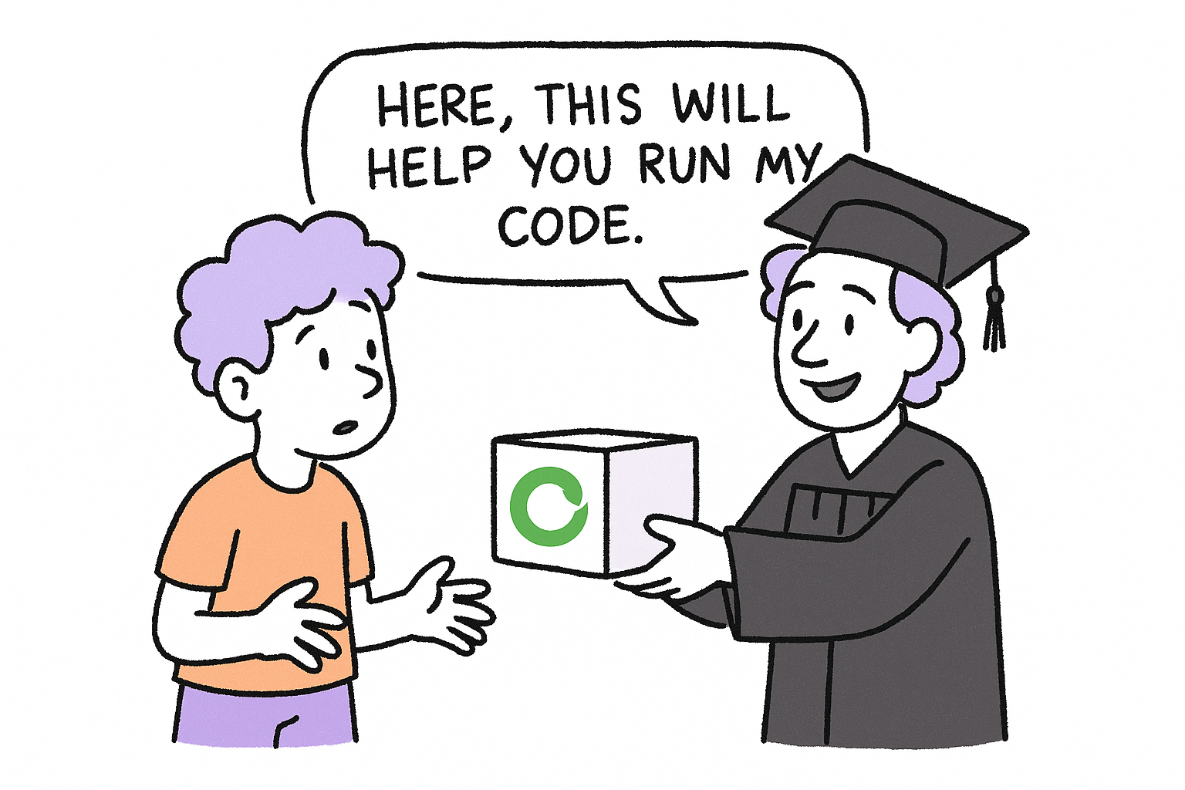
Allows creation of isolated environments with specific versions of:
  Python or R
  Packages and their dependencies
  System libraries (e.g., OpenSSL, libxml)
Works across OS (Linux, macOS, Windows) — *(packages themselves may not!)
Ensures that your code runs the same everywhere

Slide 52
Conda Best Practices and Limitations
Pin exact versions of critical packages in your environment.yml.
Use channels explicitly (conda-forge, bioconda) for consistency.
Consider mamba (a faster Conda alternative).
Combine with workflow tools (e.g., Snakemake, Nextflow) for scalable reproducibility.
Avoid mixing Conda with pip inside the same environment unless necessary.
Limitation: Conda environments are OS-sensitive (Linux ≠ Windows), so use Docker for full portability.
📦 Bioinformatics stack? Use https://bioconda.github.io

Slide 53
Virtual Machines
A virtual machine is a complete, emulated computer running inside your current system.
Includes:
  Operating system
  Software and dependencies
  Files and configurations
Think of it as a “snapshot” of a fully working research environment.
Common VM platforms:
  VirtualBox (https://www.virtualbox.org)
  VMWare
  Vagrant (for scripted provisioning)
💡 VMs are ideal when you need to reproduce everything exactly, including the OS.

Slide 54
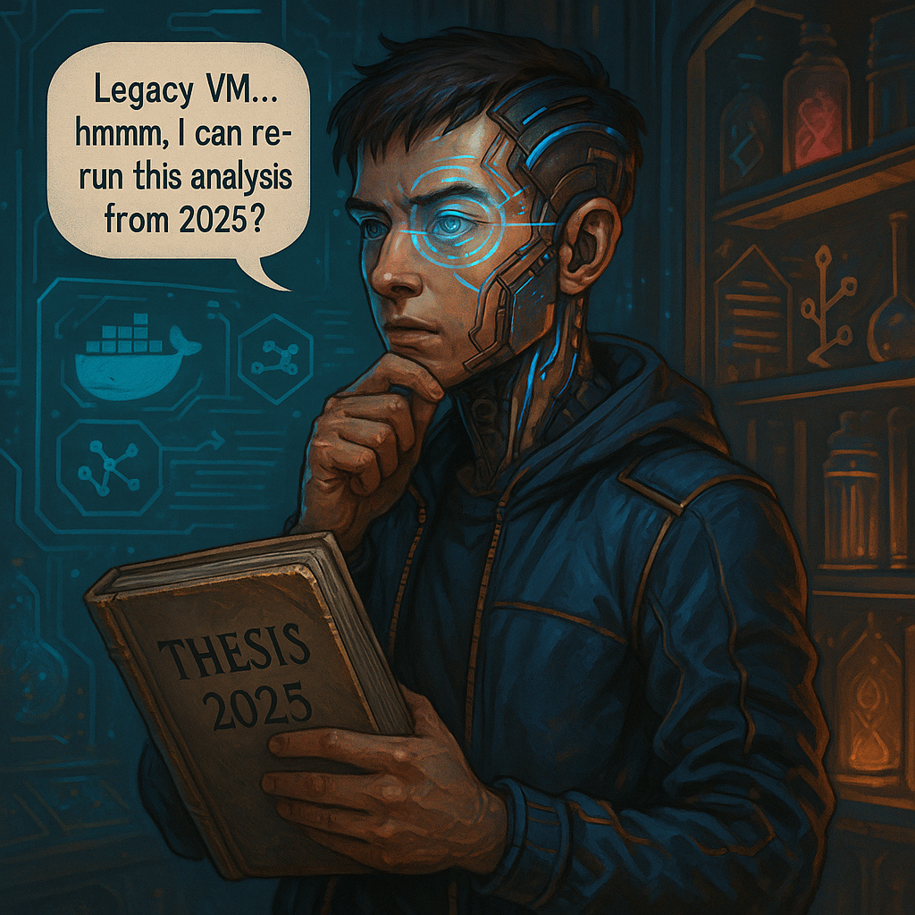
When (and when NOT) to use a VM
✔️ Advantages:
High reproducibility: includes OS + all software
Good for legacy software or GUI tools
Easily shared as .ova or .vmdk files
❌ Drawbacks:
Large file sizes (GBs)
Slower performance than native tools
Harder to version or inspect
🔧 Best use cases:
Legacy or GUI-heavy pipelines
Teaching or workshops with prebuilt environments
Institutional archiving of full research systems
📁 Bundle a VM image with your thesis so it can be re-run years later.

Slide 55
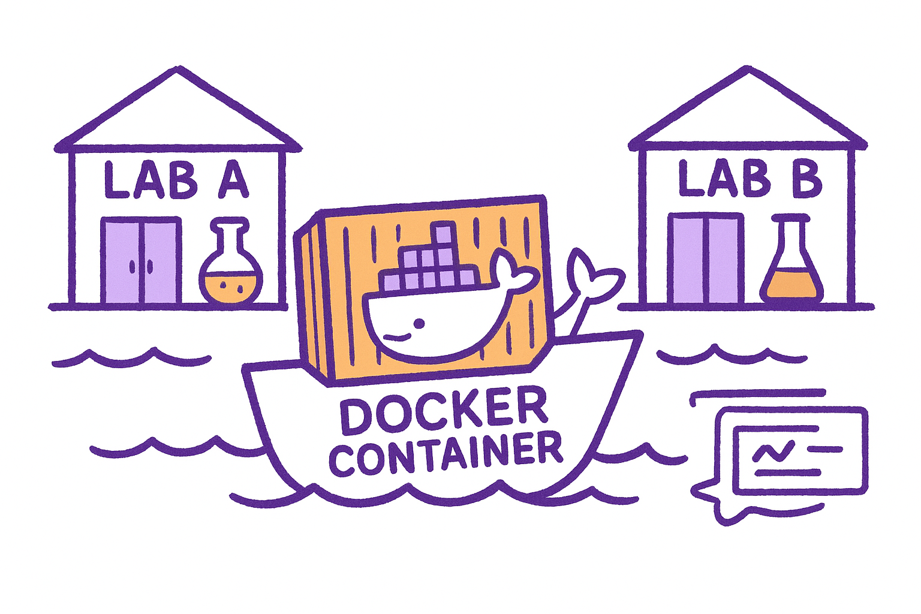
Containers: Reproducibility from Code to OS
A container is a lightweight, portable package of:
  Software
  Dependencies
  Environment variables
  Operating system libraries
Runs the same on laptops, clusters, or cloud
Can be versioned, shared, and archived
Tools:
  Docker (most popular)
  Singularity (preferred on HPC)
Enables complete reproducibility from raw data to figures
💡 Containers = lab notebooks for computational research environments

Slide 56
Building and Sharing Research-Grade Containers
Use minimal base images (rocker/r-base, python:3.10-slim)
Pin versions of OS packages and libraries
Keep data and results outside the container (mounted volumes)
Test the container on a clean system before sharing
Document usage with a README.md or labels in the image
Upload to registries:
  Docker Hub
  GitHub Container Registry
  Zenodo (with DOI)
💡 Use containers for workshops, papers, and cross-platform collaboration

Slide 57
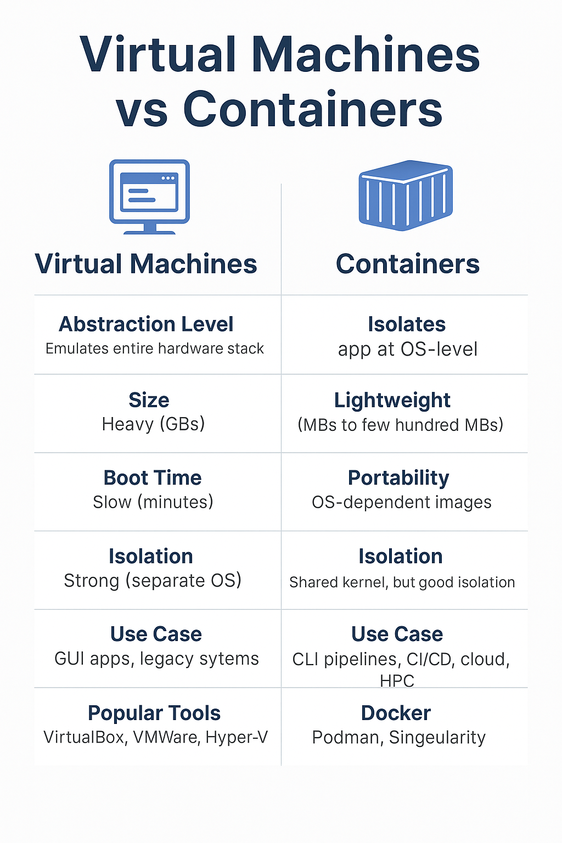
For modern scientific computing, containers are the go-to choice for portability and reproducibility.
“Homework”: Try to install and run a bioinformatics pipeline from a container image.
https://hub.docker.com/r/nfcore/rnaseq/

Slide 58
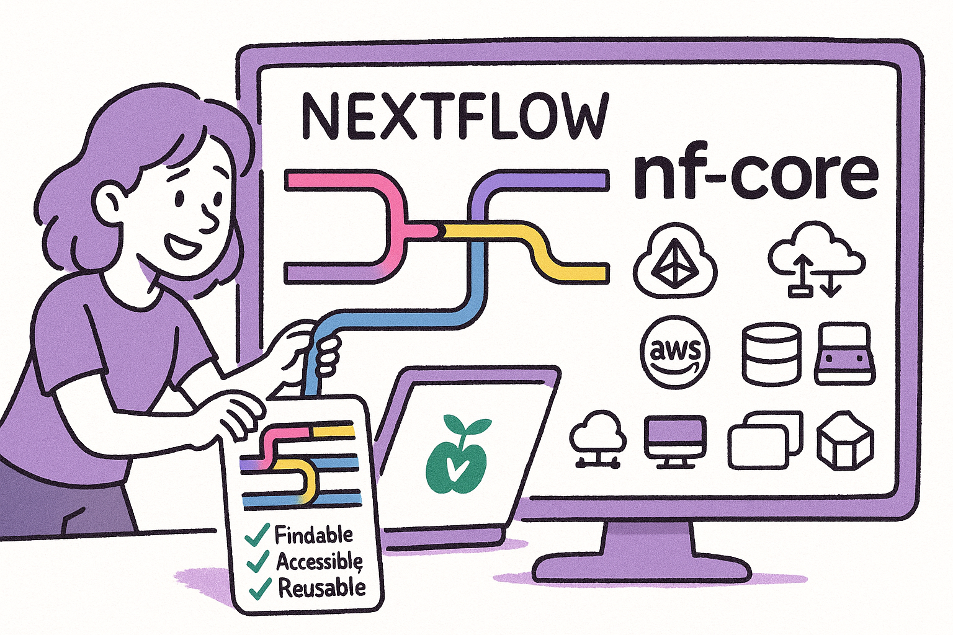
Reproducible Workflows

Slide 59
Workflows with Nextflow
A workflow management system for building portable and reproducible pipelines.
Uses a domain-specific language (DSL) based on Groovy.
Orchestrates processes in parallel, handles inputs/outputs, and manages dependencies.
Supports local, HPC, and cloud execution seamlessly.
Integrates with:
  Docker, Singularity, Conda (for reproducible environments)
  GitHub, nf-core, Tower for sharing and monitoring
🧠 Built for scientists: no need to reinvent the pipeline wheel.

Slide 60
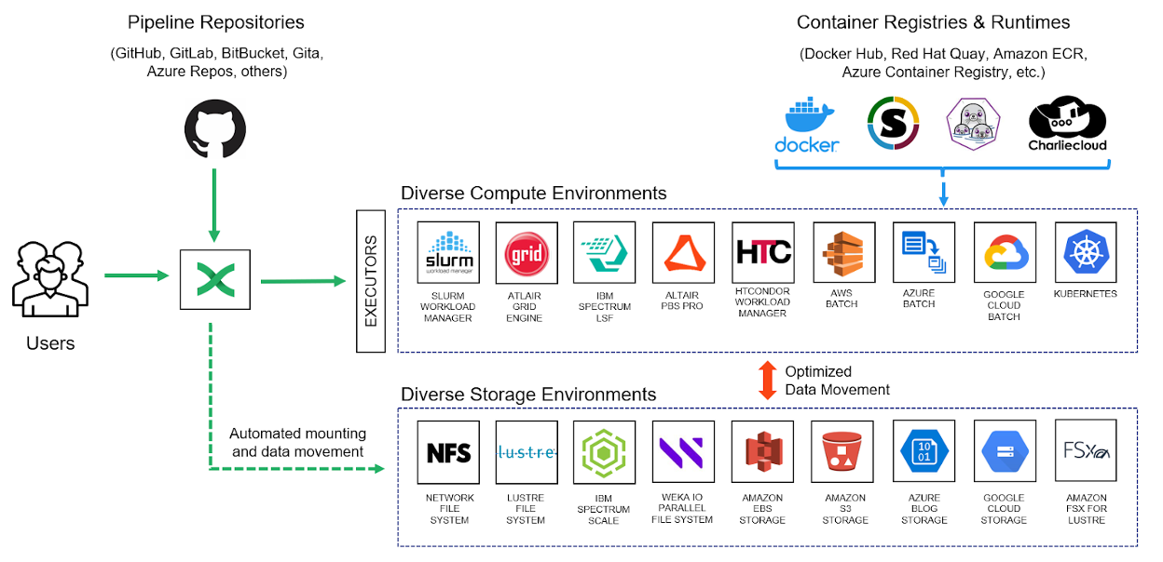

Slide 61
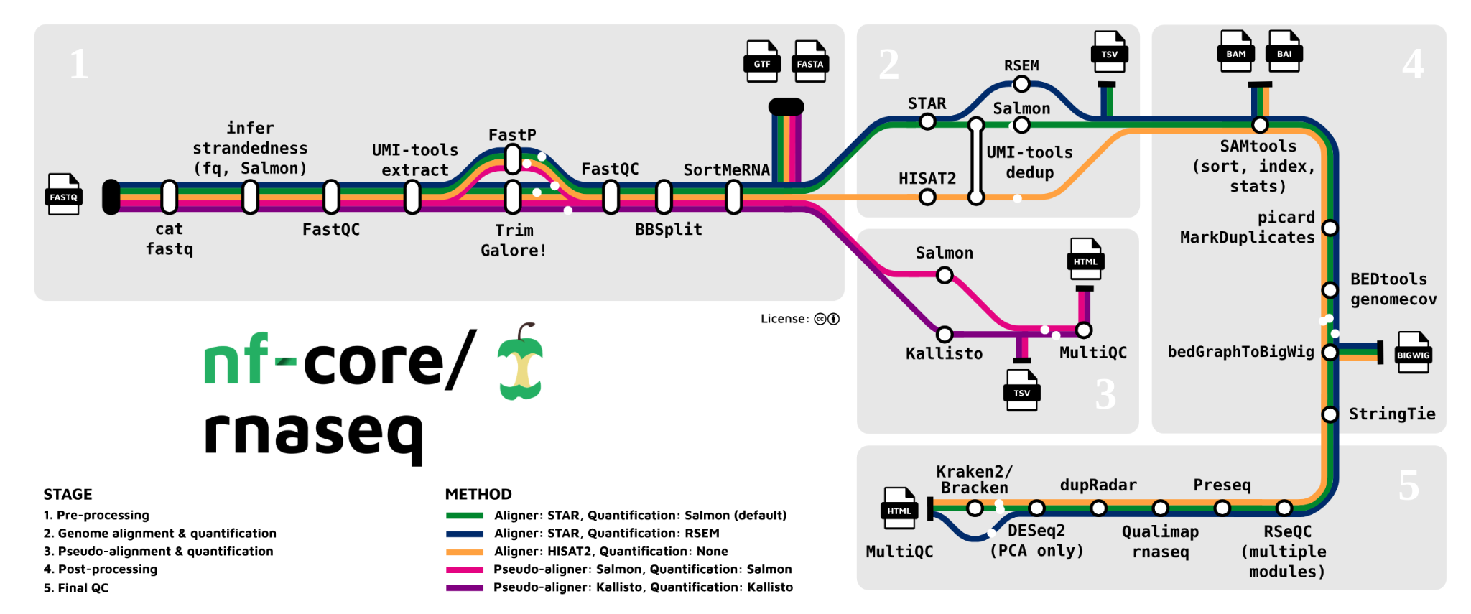
✔️ Portability: Write once, run anywhere (laptop → HPC → AWS)
✔️ Reproducibility: Fix environment with containers and version control
✔️ Modularity: Reuse well-tested components (processes)
✔️ Scalability: Parallel execution across thousands of jobs
✔️ Community support: The nf-core ecosystem provides best-practice pipelines
🔗 Workshop: https://carpentries-incubator.github.io/workflows-nextflow/

Slide 62

Research Compendia
A research compendium is a concept:
A complete, structured bundle of all the components needed to reproduce a research project.
That includes code, data, environment specs, documentation, and sometimes the paper itself.

Slide 63
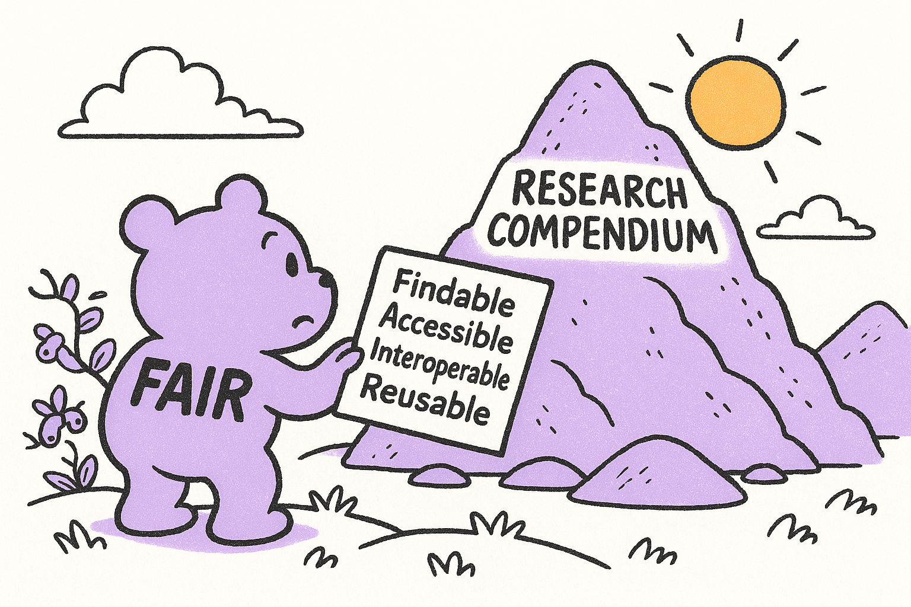

Slide 64
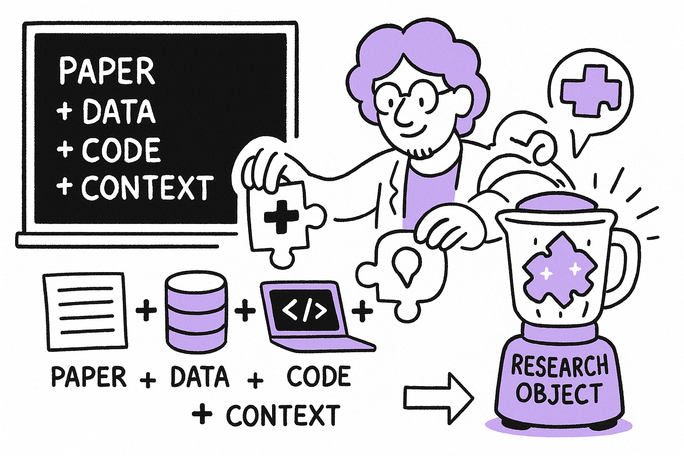
Research Objects: More Than Just a Paper
A Research Object (RO) is a structured bundle of digital resources that fully describes a research investigation.
Goes beyond traditional publications: includes data, code, workflows, metadata, results, and documentation.
Goal: Make research reproducible, transparent, portable, and machine-readable.
Think of it as a digital lab notebook meets publication archive.

Slide 65
RO-Crate: A Lightweight RO Format
RO-Crate is a modern, lightweight standard for describing Research Objects using:
  A structured folder
  A JSON-LD metadata file (ro-crate-metadata.json)
Designed to be easy to create, share, and validate
Follows FAIR principles: Findable, Accessible, Interoperable, Reusable
Can describe:
  Data files (raw, processed)
  Software/scripts
  Workflows (e.g. Nextflow, CWL)
  Authors, methods, licenses
📦 “Just zip it and ship it” — RO-Crate makes compendia self-describing.

Slide 66
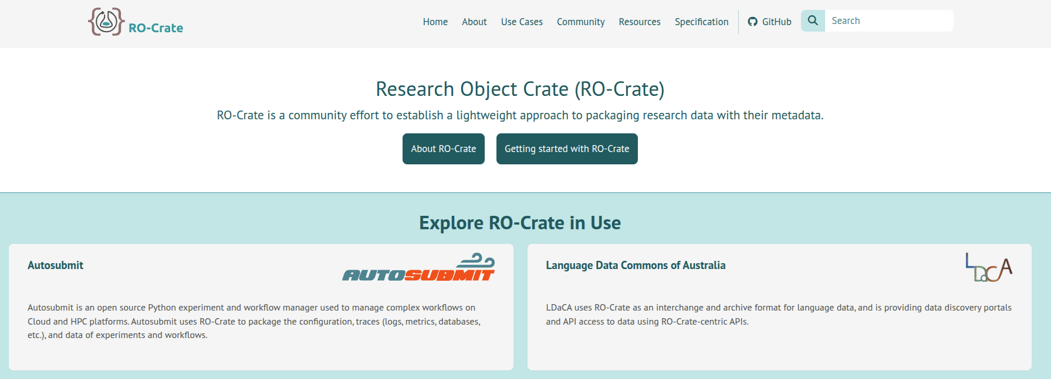
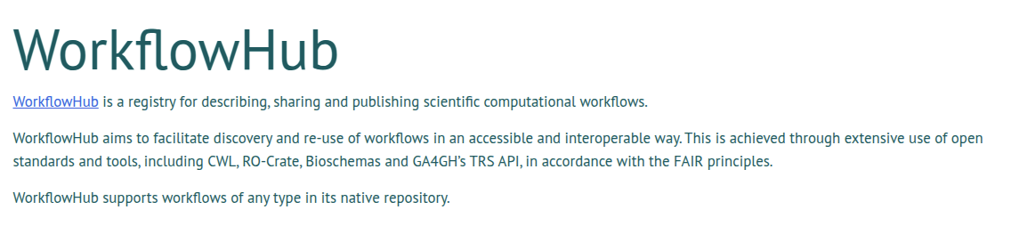
https://www.researchobject.org/ro-crate/

Slide 67
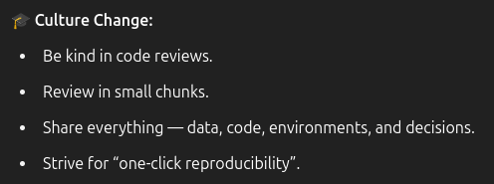
✅ Reproducibility is not optional … it’s foundational.
Version Control (Git): Track code history, collaborate, and review effectively.
Code Review: Catch bugs, improve quality, and share knowledge through peer review.
Data Management: Structure, document, and version datasets (DVC, Git LFS).
Environments: Capture dependencies with Conda or Docker.
Containers vs VMs: Containers for portability and scale; VMs for full-stack snapshots.
Workflow Automation: Use Nextflow/(Snakemake) to make analyses reproducible and scalable.
Research Compendia: Bundle data + code + environment + documentation into a reproducible package.
RO-Crate: Make compendia machine-readable and FAIR-compliant.
🚀 Reproducibility is a habit, not a hurdle. Make it part of how you work.

Slide 68
A good Bioinformatics project
MUST HAVE reproducibility through version-controlled code, clear data provenance and fully documented methods you can run end to end.
SHOULD HAVE thorough documentation of assumptions, well-annotated scripts and automated tests that catch regressions early.
COULD HAVE interactive notebooks, containerized environments for easy setup and community-driven templates that guide contributions.
WON’T HAVE hidden dependencies, proprietary formats or untested one-off scripts that can’t be inspected and re-executed.

